Slide 1
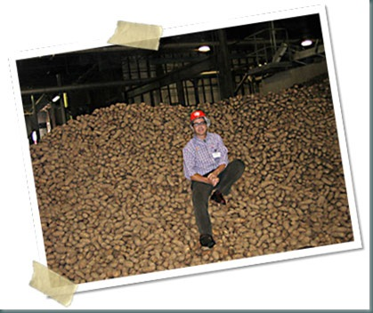
Allen Kurzweil
Image retrieved from http://potatochipscience.com/
Literary Genius…
Author Study
by Shannon Jephson-Hernandez
EDLT 421 / Summer 2011

Slide 2
Biographical Sketch
A K
L U
L R
E Z
N W
E
I
L
Raised in Europe & the USA
Was not a great student
Educated at Yale & University of Rome
Freelance journalist in France, Italy & Australia for 10 years
Fascinated with inventions

Slide 3
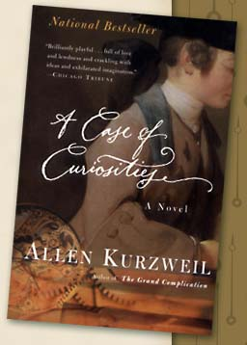
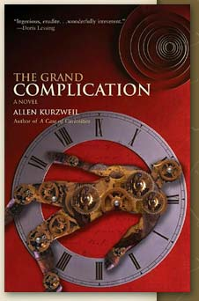
For Adults
A Case of Curiosities (1992)
First novel
Internationally recognized
Translated in 12 languages.
Takes place in the 18th Century
About a “Mechanical Genius”
The Grand Complication (2001)
Second Novel
Spent 5 years doing research throughout Europe
Expresses a passion for invention
Takes place in the 20th Century
Images retrieved from http://www.allenkurzweil.net/index.php?id=curiosities
Images retrieved from http://www.allenkurzweil.net/index.php?id=complication

Slide 4
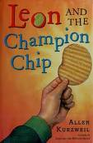
LRAs For Students
Leon And The Spitting Image (2003)
Write a confession to the police as though you were Leon, and they discovered what you had done with the spitting image.
Create an advertisement for the Trimore Towers, letting customers know of all of the benefits they will receive when they stay at the hotel.
Leon And The Champion Chip (2005)
Write a Haiku or song about your favorite food or collection.
Write a sales pitch to your science teacher explaining what subject you think should be the focus for the year and why. Be convincing.
Using Leon’s “Moodometer,” choose 3 settings and write about three different experiences in your life where you felt similar to Leon’s definitions.
Design your own flavor of potato chips and create a TV commercial to convince others to buy them.
Images retrieved from http://leonzeisel.com/index.php?s=spitting_image
Images retrieved from http://leonzeisel.com/index.php?s=champion_chip

Slide 5
Potato Chip Science
Haiku
Dad sniffs my fingers,
They smell like potato chips,
I am so busted.
Allen Kurzweil Video
Potato Chip Science Website
Dichotomus Classification (CHPT 12, 25, 26)
Exothermic Reaction (CHPT 14)
Electrolytic Energy (CHPT 16)
Aerodynamics & Spore Growth & Optics (CHPT 19)
Spectral Analysis (CHPT 22, 26)
Microscopy (CHPT 22)
Static Electricity (CHPT 23)
Observational Analysis (CHPT 22, 25)
Liquid Nitrogen: Unconventional Applications (CHPT 34)
pH Analysis (CHPT 38)
(Kurzweil, 2005)

Slide 6
Web Sources
LeonZiesel The official website for the Leon Ziesel series written for students.
Author Review
Author Biography by Book Browse
Author Website
This website is the official source of information about the author and his work for adults.
Become a Fan (Facebook link)

Slide 7
Annotated Bibliography
Kurzweuil, Allen. (2003). Leon and the spitting image. New York: NY. Greenwillow Books.
This hysterical tale of young Leon’s experience of coping with fourth grade, a class bully, an eccentric home life, and the world’s scariest teacher is bound to have readers of all ages rolling on the floor. Perfect for grades four and up. Can be read as a class read aloud or for individual reading experiences. This book is considered realistic fiction, but contains some fantasy.
Kurzweuil, Allen. (2005). Leon and the champion chip. New York: NY. Harper Trophy.
Kurzweil’s classic characters return to school for fifth grade to discover they have lost their controlling power over the school bully. In a quest to regain their power they discover new interests and a fascination for science class. Leon learns that science is everywhere, even in his beloved potato chips. Although the book maintains Kurzweil’s humorous setting, the tales present values of family, friendship and education in a meaningful manner.

