Slide 1
Bill Nye Cells

Slide 2
Success Criteria
Learning Target
I can evaluate information about cells to identify their impact on living organisms
Complete a T-chart identifying the positive benefits and negative impacts of cells.

Slide 3
How do cells have positive and negative impacts on living organisms?
Complete a T-Chart while watching Bill Nye

Slide 4
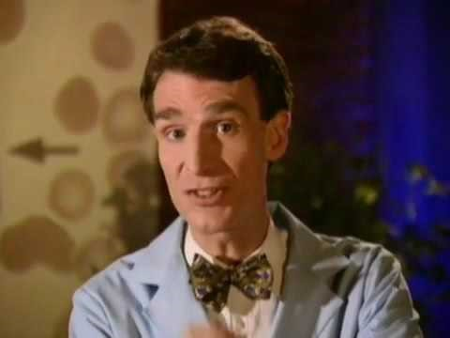
Bill Nye the Science Guy
“CELLS”
Complete Middle Check

Slide 5
Share talking points with the class
Complete End Check

Slide 6
REVISED THOUGHTS:
1. What was surprising?
2. What did you already know but see in a new way?
3. What do you still need help with?

