Slide 1
STRUCTURE & FUNCTION of CELLS

Slide 2
Initial Thoughts (4 min)
1) What are all living things made of?
2) How are plant and animal cells the same?
3) How do toxins get inside living things?

Slide 3
Success Criteria
Learning Target
Understand the structure and function of cell parts/sub-systems within the cell.
Construct cell analogies for 3-6 organelles & describe a real world job they remind you of.

Slide 4
Why are cells important to living organisms?

Slide 5
Each cell is made up of…
Organelles (Cell Parts)
Each organelle has a specific function for the cell, just like each organ has a specific function for the organ system.
Ex: The CELL MEMBRANE’s function is TO ALLOW CHEMICALS TO GO IN AND OUT OF THE CELL, an organ has a function too, like the HEART’s function is to MOVE THE BLOOD THROUGHOUT THE VESSELS TO ALLOW NUTRIENTS TO GO TO THE REST OF THE BODY.
*DRAW AN INVERTED PYRAMID TO COMPLETE THE NEXT SLIDE…

Slide 6
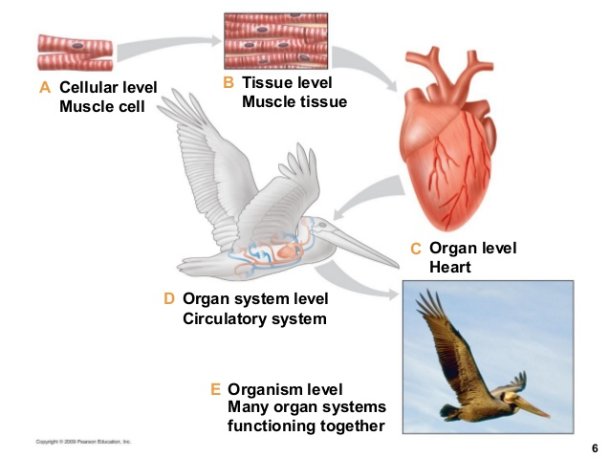
All Livings things are made of…
CELLS
CELLS make up TISSUES…
TISSUES form ORGANS…
ORGANS help build ORGAN SYSTEMS…
EX: The MUSCLE CELLS makes up MUSCLE TISSUES, which form muscles like the HEART which is part of the
CIRCULATORY SYSTEM.
Can you come up with another example???
DRAW A FLOW CHART FOR a system that uses cells.

Slide 7
“Cells, Cells, They are made of Organelles” RAP

Slide 8
CELL ANALOGIES What does each cell part’s job reminds you of?
Organs are to bodies as Organelles are to cells
Skin is to bodies as Cell Membranes are to cells
At the end of this lesson you will write analogies for:
Cytoplasm, Mitochondria, Vacuole, Cell Wall, Nucleus

Slide 9
Cell Mix n’ Match (10 min)
Match the different parts of the cell with the function and image with a partner.
SEE NEXT SLIDE for RESOURCES

Slide 10
Resources
Students can use the following animated cell websites to figure out which part belongs to each function and picture:
Sciencesauraus Pg 77-78
Sheppard Software’s – Click on Tutorial – easier website to use to find specific cell parts
Bioman Biology – Click on Game Style – High School Level information of a cell
(COMPLETE MID-CHECK WHEN DONE)

Slide 11
PEER REVIEW
BE READY TO SHARE OUT YOUR ANSWERS
We will use the document camera to compare results. I will call on one student at a time to come up and place either a picture or definition. The class is responsible for monitoring the placements for accuracy.
Discuss the following:
1) Which organelles do only plants have and not animal cells?
Why do they need those organelles to survive?

Slide 12
EXIT TASK: CELL ANALOGIES What does each cell part’s job reminds you of?
Organs are to bodies as Organelles are to cells
Skin is to bodies as Cell Membranes are to cells
At the end of this lesson you will write analogies for:
Cytoplasm, Mitochondria, Vacuole, Cell Wall, Nucleus
(COMPLETE REVISED THOUGHTS & END CHECK)

