Slide 1
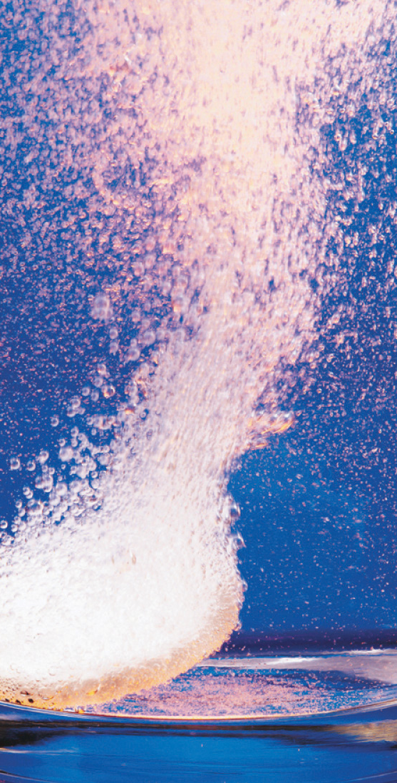
Introduction to Chemical Reactions
Atoms, Molecules, Elements, Compounds, and Mixtures

Slide 2
Today’s Plan
EQ: How do chemical reactions work?
LT: Obtain information about the structure and function of chemical reactions.
SC: Use any note taking strategy to summarize how atoms combine to form new substances.

Slide 3
INITIAL THOUGHTS
Describe how chemical reactions occur.

Slide 4
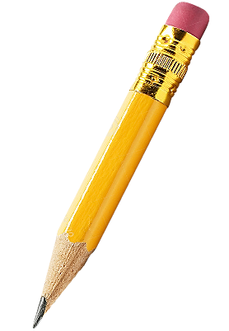
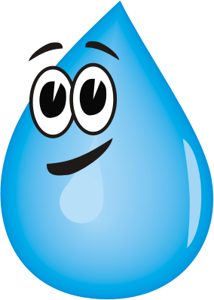
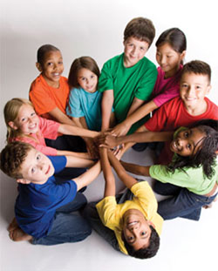
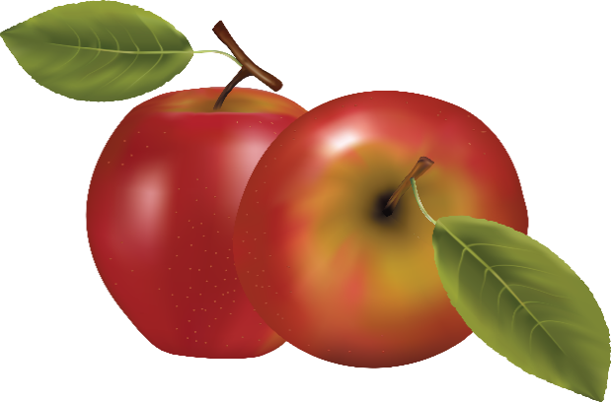
An atom is the smallest basic unit of matter.
There are 109 different types of atoms. These atoms can combine in different ways to make up anything that you can think of. Even you are made of atoms.

Slide 5
Atoms are EXTREMELY
Small.
Millions of atoms would fit into the period at the end of this sentence. Now just think of how many atoms you have in your body.
Notes:
In the human body, we have 7 x 10²⁷ . Ninety-nine percent of the atoms in the human body can be divided into the following amounts: 65 percent hydrogen, 24 percent oxygen and 10 percent carbon. The other 1% is trace elements like copper and lead and boron.

Slide 6
When two or more atoms bond together, they form a particle called a molecule.
Water is known as H₂O because it is a molecule that is composed of two hydrogen (H) atoms and one oxygen (O) atom that are BONDED…..CHEMICALLY BONDED together.
H
H
O
Notes:
Chemically bonded means that atoms are joined. An analogy is that you and two friends are holding hands and can’t let go.

Slide 7
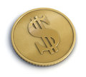
THERE ARE TWO TYPES OF MOLECULES
An element is a substance that contains only a single TYPE of atom.
The number of atoms doesn’t matter as long as they are all the same type.
Gold, for example, is an element. A gold coin contains millions and millions of atoms, but all of the atoms are the same type of atom, gold.
Notes:
Some other examples are sodium, Na, chloride, CL, oxygen (O) and hydrogen (H)

Slide 8
Periodic Table of Elements. Elements include the oxygen (O) that you breathe and helium (He) in floating balloons.
Notes:
You may recognize the names of many of these elements in the Periodic Table.

Slide 9
The second type of molecule is something called a compound.
A compound is a substance that consists of two or more DIFFERENT types of atoms bonded together.
Let’s look at that water molecule again. Why do they call water H₂O?
H
H
O

Slide 10
An amazing thing about compounds is that when you combine the different types of atoms/elements, you often get a compound with properties that are very different from the properties of the atoms that made it.
For example Sodium Chloride (NaCl) is a common compound made up of two different types of atoms.
Na
Cl

Slide 11
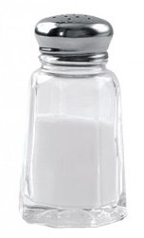
Sodium (Na) is a metal that is poisonous.
Chlorine (Cl) is the white chemical that many people use to clean their swimming pools. In larger doses, it is also poisonous.
When you bond together these two atoms which are poisonous, what do you get?
Can you imagine eating
French fries without this
beautiful bonding of two
poisonous elements?
Na
Cl
Table salt!

Slide 12
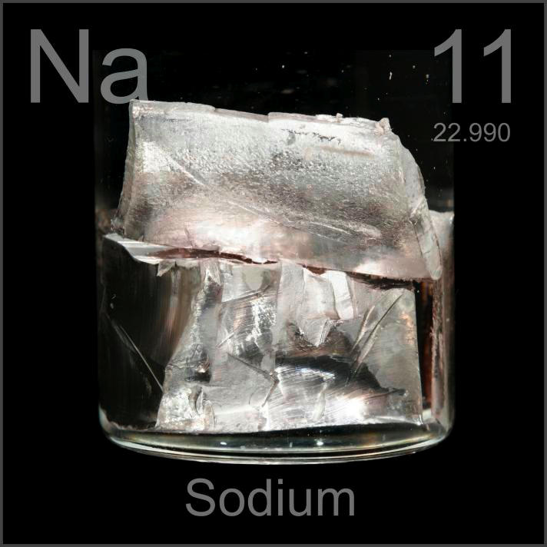
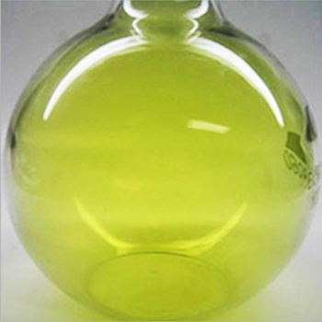
Cl 17
Chlorine
A toxic soft metal
Can be cut with a knife
Highly reactive with water
A toxic gas
Burns the skin and eyes
May be fatal if inhaled
Video: Reaction of Sodium and Chlorine
https://www.youtube.com/watch?v=VBReOjo3ri8

Slide 13
Reminder: Water/H₂O is a bonding of two hydrogen atoms and one oxygen atom. Both hydrogen and oxygen are gases that are explosively flammable.
When you bond them together,
you get water, a liquid that
certainly isn’t flammable.

Slide 14
Not everything that contains two or more atoms is a compound. Many of these combined atoms are mixtures.
A mixture is a combination of different substances that remain the same substances and can be separated by physical means.
In other words, the substances are not bonded together. Nothing NEW is created. It is the just the same substances mixed together.

Slide 15
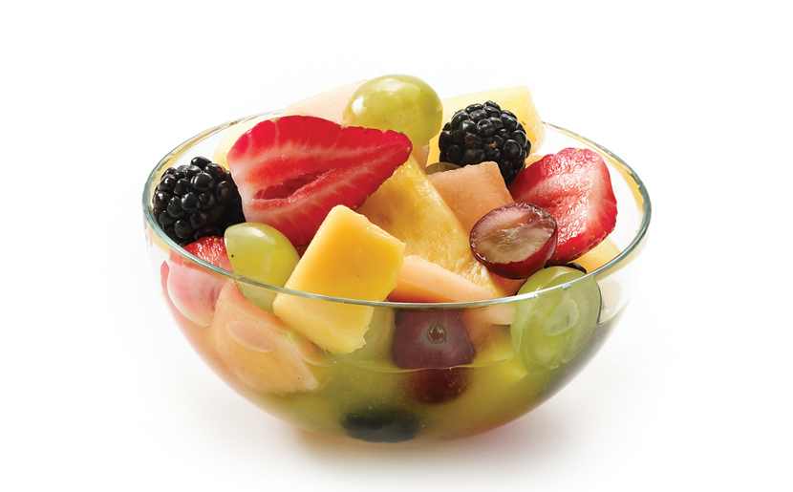
A good example of a mixture is a fruit salad.
Do the fruits combine/bond
to make a totally NEW fruit?
Of course not.
AND the fruit salad can be separated by physical means.
Notes:
In a mixture it is possible to separate the different elements from each other, they mix but don’t combine. In a mixture, atoms do not combine.

Slide 16
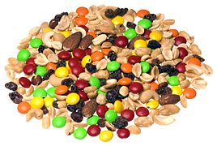
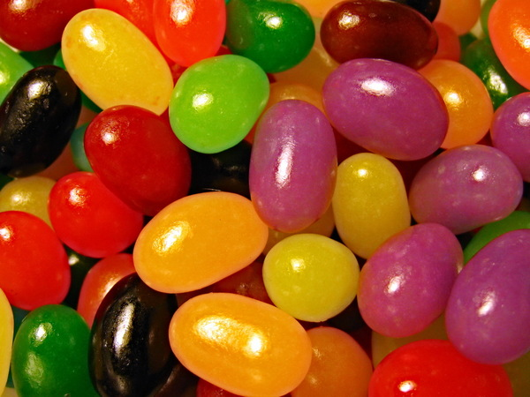
You cannot do this with a compound such as water. There is no way to physically pick out the oxygen (O) atoms in water. Even if you could break the chemical bonds between H and O, what was left would no longer be water. It would just be a collection of hydrogen atoms.
Another difference between mixtures and compounds is that mixtures can have varying proportions within the mixture. For example, no two scoops of a fruit salad will have the same amount of each fruit in it.

Slide 17
In a compound, the substances that bond together are always the same. In addition, they always bond in the same proportion.
There is no such thing as water with less hydrogen. Each molecule of water must have exactly 2 hydrogen atoms bonded with 1 oxygen atom. There is no way of varying this.

Slide 18
Elements & Compounds
Counting elements in a molecule:
Count the number of different capital letters or element symbols in the compound.
Na₂O
2 – Na + 1 – O

Slide 19
Quick practice - Elements and Compounds
Get with your table group and discuss how to count the number of different elements in a compound.
Complete the chart by counting the elements and naming them.
Formula | # of different elements | Name of elements
CO2
H2O2
C₆H₁₂O₆
NaOH
Notes:
These are all compounds.

Slide 20
Here is a short multiple choice test to see how well you have absorbed this information.
Question 1
What is it called when two or more DIFFERENT types of atoms bond together?
an element B. a compound
C. a mixture D. molecule
Notes:
Try out your new knowledge with this quiz!

Slide 21
That is incorrect.
Try again.

Slide 22
That’s correct!
A compound has DIFFERENT types of atoms bonded together.
If you were thinking of a molecule, remember that a molecule is two or more atoms bonded together.
Those atoms could be the same (an element)
or different (a compound).

Slide 23
Question 2
What do you call a combination of different substances that remain the same substances and can be separated by physical means?
an element B. a compound
C. a mixture D. molecule

Slide 24
That is incorrect.
Try again.

Slide 25
That’s correct!
In a mixture the substances are combined, but are NOT bonded together.

Slide 26
Question 3
What do you call it when two or more of the SAME TYPE of atom bond together?
an element B. a compound
C. a mixture D. molecule

Slide 27
That is incorrect.
Try again.

Slide 28
That’s correct!
In an element there may be millions and millions of atoms bonded together, but each is the SAME TYPE of atom.

Slide 29
Question 4
Pure gold is an example of ….
an element B. a compound
C. a mixture D. molecule

Slide 30
That is incorrect.
Try again.

Slide 31
That’s correct!
An element!
There may be many millions of gold atoms bonded together in even a small piece of gold. If it is PURE gold, then every atom is the SAME TYPE of atom (gold atoms).

Slide 32
Question 5
When two or more atoms bond together they form a ……
an element B. a compound
C. a mixture D. molecule

Slide 33
That is incorrect.
Try again.

Slide 34
That is one possibility, but there is a better answer.
Try again.

Slide 35
That’s correct!
Molecule is the BEST answer to the question. It’s true that compounds and elements are both collections of molecules and are not exactly wrong answers. However, in a compound the atoms have to be DIFFERENT. In an element the atoms have to be the SAME type. The question didn’t say whether the atoms were the same type or not. Therefore, molecule is the BEST answer.

Slide 36
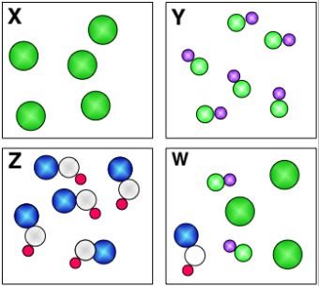
For each of the diagrams
(X, Y, Z and W),
Is it an element, compound
or mixture?

Slide 37
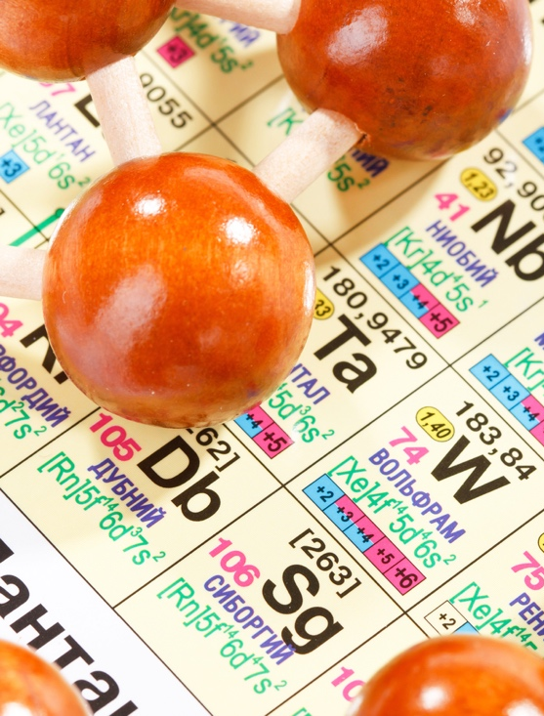
Check for Understanding
Can you…
Differentiate between elements, compounds,
and mixtures?
H₂O out.
Notes:
Physical vs chemical changes video: https://www.youtube.com/watch?v=ANOtoVBAzDU. If I took a piece of paper and crumpled it, physical or chem change (physical)? If set it on fire (chemical)? If turned it into a paper airplane (physical)? Shredded it (physical).

