Slide 1
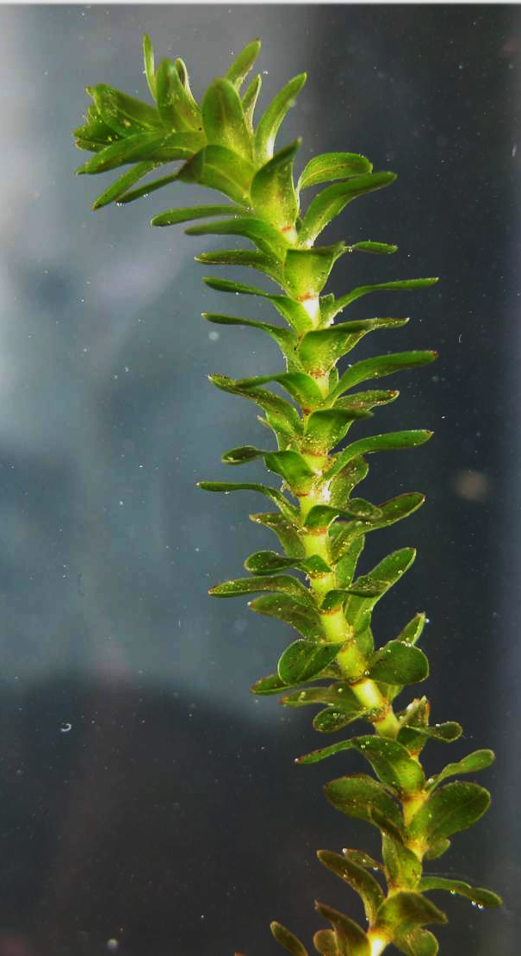
Elodea Lab

Slide 2
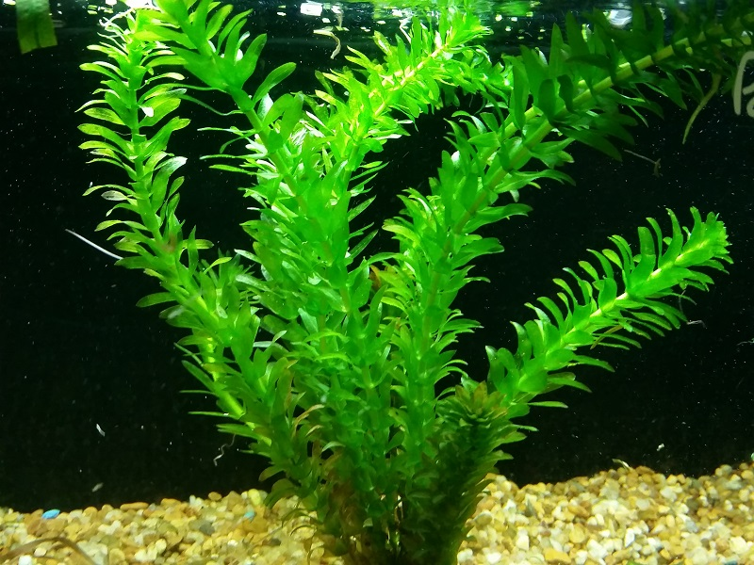
Learning Target
I can conduct an investigation to determine the relationship between direct light and the rate of photosynthesis.
Success Criteria
Measure and collect data to identify the variables/factors that impact the rate of photosynthesis.

Slide 3
Today’s Experimental Question:
How will the rate of photosynthesis change if the amount of direct light on Elodea is increased?

Slide 4
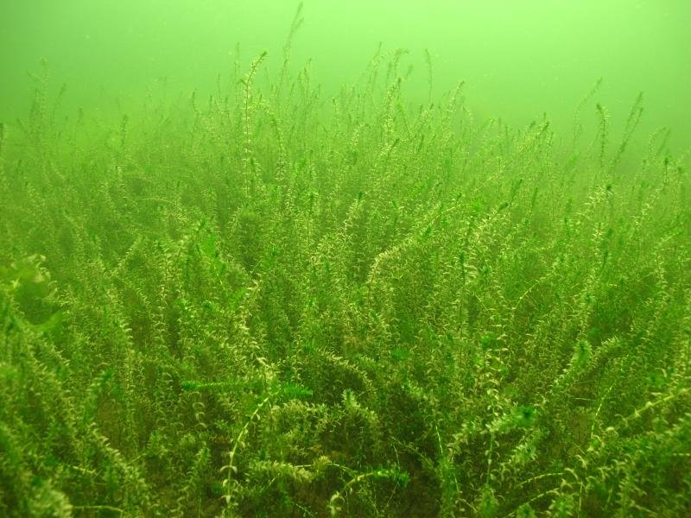
1. Identify the 3 variables in the experiment, and write them in your notebook:
Before we begin today’s lab, we must first:
Independent:
Dependent:
Control:
2. Write a hypothesis (see next slide).
This is based on what you think will happen in the experiment, your best educated guess.

Slide 5
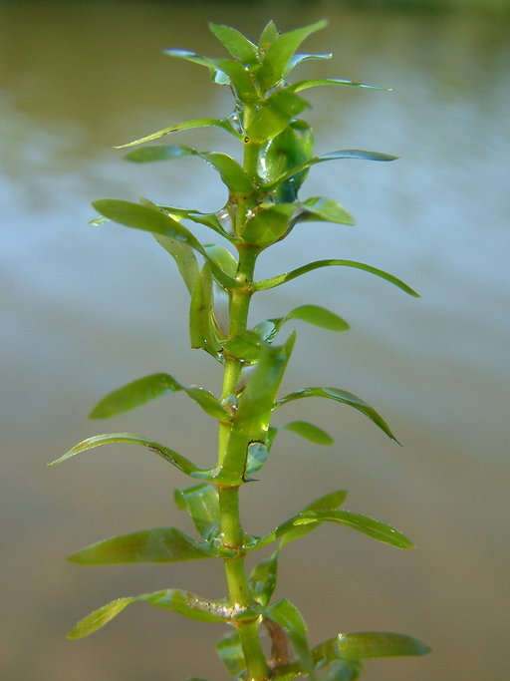
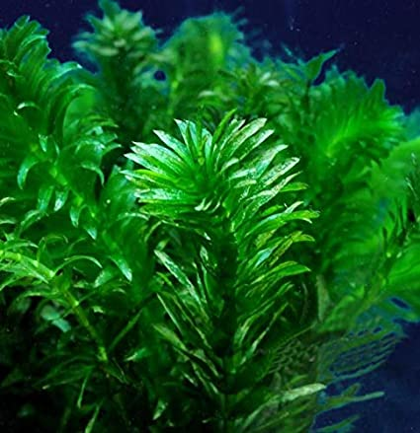
Hypothesis: Use the if…then…because formula!
If the amount of direct light is increased in Elodea, then the rate of photosynthesis will (increase/decrease, select one) ________________ because ___________________________________
__________________________________________.

Slide 6
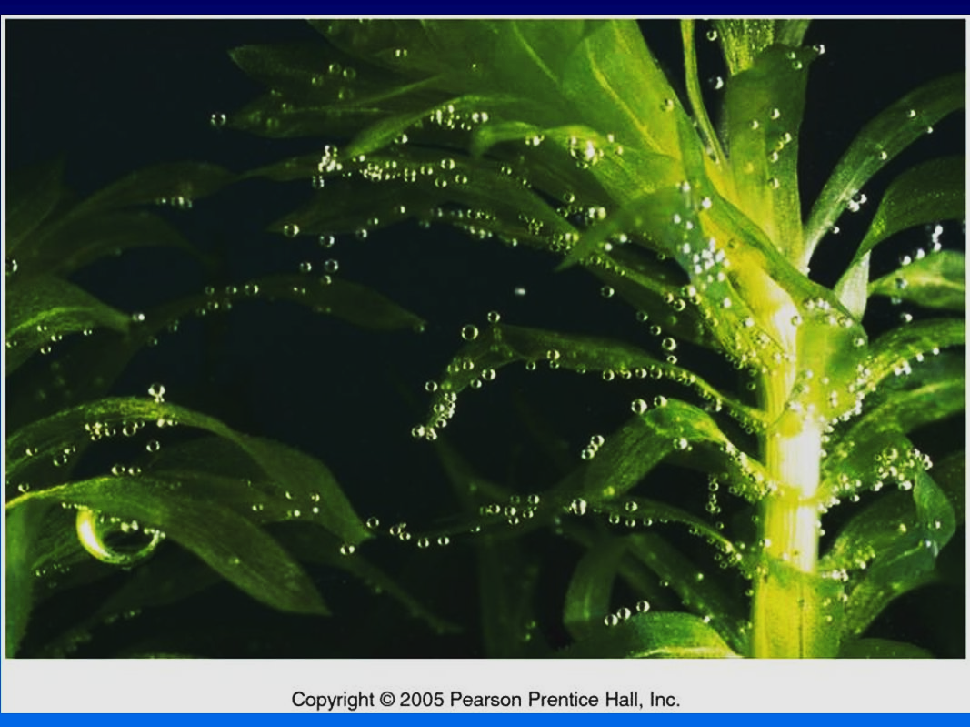
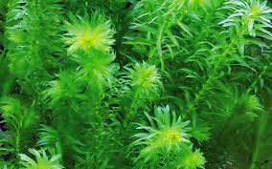
Let’s review the data table.

Slide 8
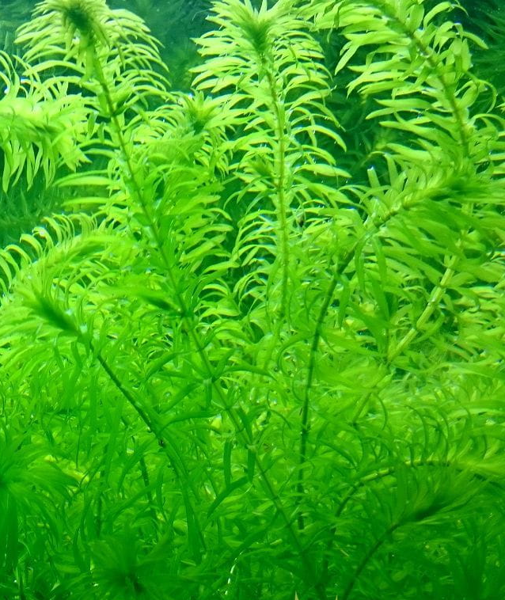
Proceed to today’s lab:
Measuring the Rate of Photosynthesis of Elodea at http://www.reading.ac.uk/virtualexperiments/ves/preloader-photosynthesis-full.html

Slide 9
Procedures for Elodea Lab: Click on the Elodea Lab Link on whatsyourscience.com
For Distance #1, drag the light 100 cm away from the plant (see the Instructions in the Lab). You will select three distances during this experiment to measure the rate of bubbles being released at each distance (review the data table before proceeding to see what data you will be collecting). Record the first distance.
Click on the Start screen, then click on the tab that says “Counter,” not “BPM” or “bubbles per minute.”
You will see bubbles being released, one at a time, from the Elodea plant.
Find a spot on the screen where you want to count the bubbles as they rise. One spot is when a bubble leaves the plant near the bottom of the screen. Another spot is right before the bubble disappears at the top of the screen.
When the red second hand is on 12 on the clock, press the “+” button. You will see the counter move from ‘0’ to ‘1’
Click the “+” button every time the plant releases one bubble.
Repeat the process (keep clicking when bubbles are released) until the red second hand is back on the 12 on the clock, so you count the # of bubbles released during a one-minute period of time. Record # bubbles counted.
Conduct two more trials to average your data.
For Distance #2, move the light further away from the plant and record the new distance on the data table.
Repeat steps 5-7, and record the new rate of bubbles per minute (the rate of photosynthesis).
For Distance #3, move the light even further away from the plant and record this new distance on the data table
Repeat steps 5-7, and record the new rate of bubbles per minute.
Under High/Low Quantitative Data: Determine which distance has the highest rate of photosynthesis (bubbles per minute) and which distance has the lowest.
Record the mathematical difference between the three distances (subtract the lowest distance from the highest distance).
Take a look at the highest and lowest rates of photosynthesis. Is there a significant difference between the two numbers (i.e., are the numbers close together? If no, not significant. If they are far apart, there is a significant difference between them).

Slide 10
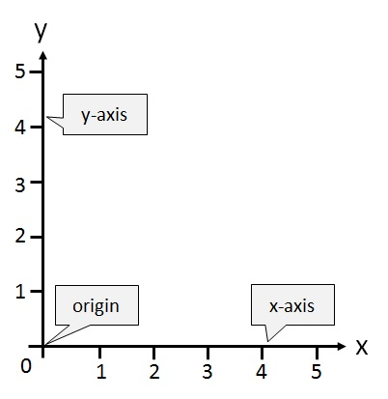

Once you have collected the data and completed the data table, create a graph based on this data.
Create a graph on a piece of paper with the following: title, label the x and y axes, and add numbers on the axes that are equally distant apart (such as 0, 5,10, 15 or 0, 20, 40, 60…)
Make a bar graph of the three distances and how many bubbles were counted per minute on average.
Rate of Photosynthesis (bubbles/min, dependent)
Amount of Direct Light (Independent)

