Slide 1
Learning target
I will be able to explain the energy transformations through
a system.

Slide 2
Success criteria
I know I got it when I am able to recognize and label different forms of energy in a lab activity.

Slide 3
Read the scenario on the paper provided and answer the question. Explain your reasoning.

Slide 4
Energy Transformations Text
You should have identified various forms of energy and read how energy changes from one form to another in your Actively Learn Homework assignment.
Let us look at some of the forms as revision.

Slide 5
There are many forms of energy, but they can be grouped under potential and kinetic energy.
POTENTIAL ENERGY
CHEMICAL ENERGY
KINETIC ENERGY
MECHANICAL ENERGY
LIGHT ENERGY
SOUND ENERGY
THERMAL ENERGY
ELECTRICAL ENERGY

Slide 6
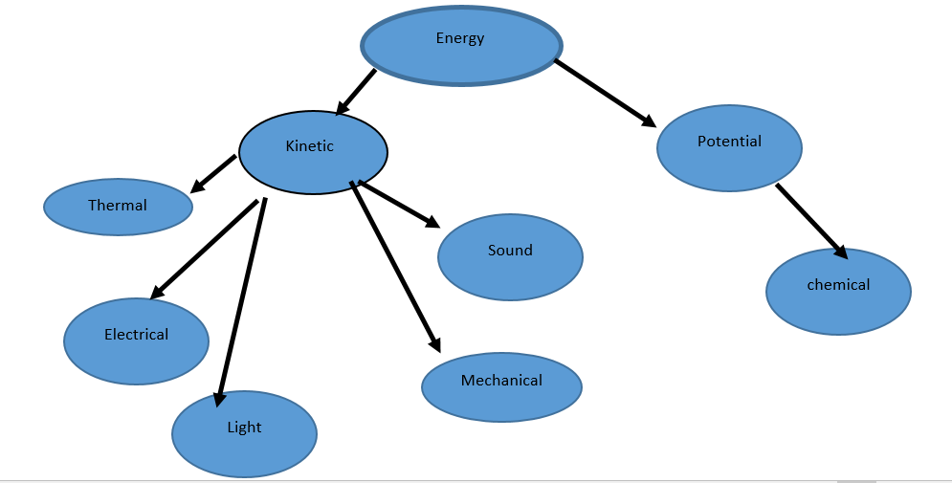
Concept Map

Slide 7
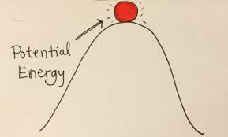

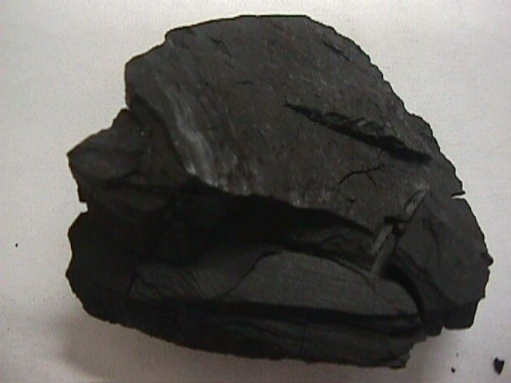
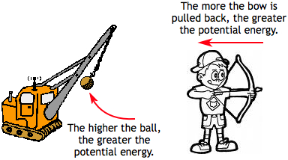

Potential energy: is stored energy

Slide 8
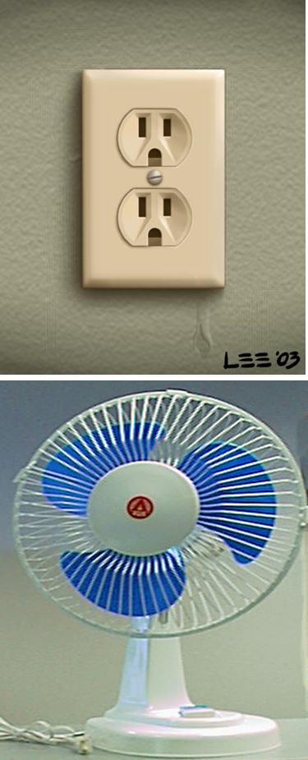
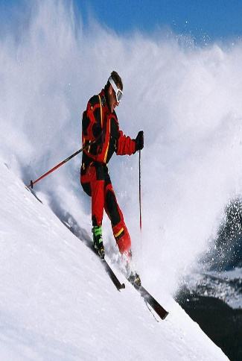
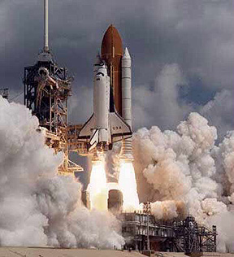
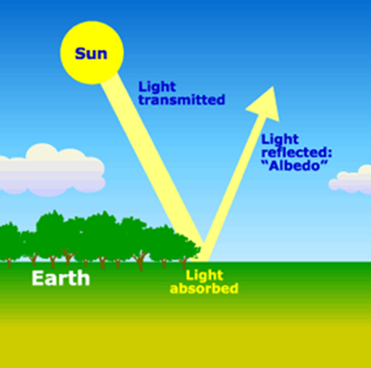
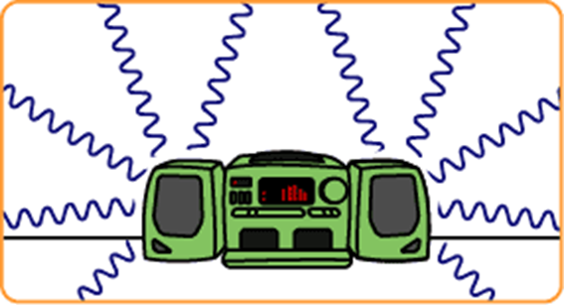

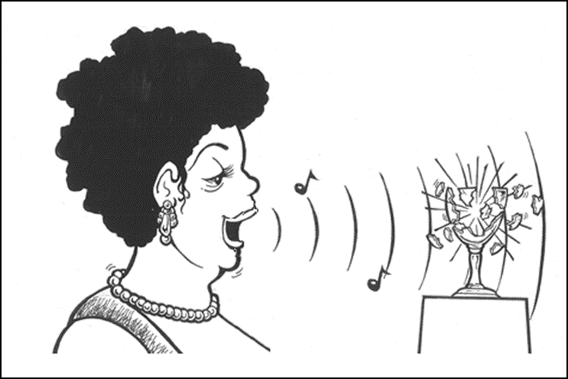
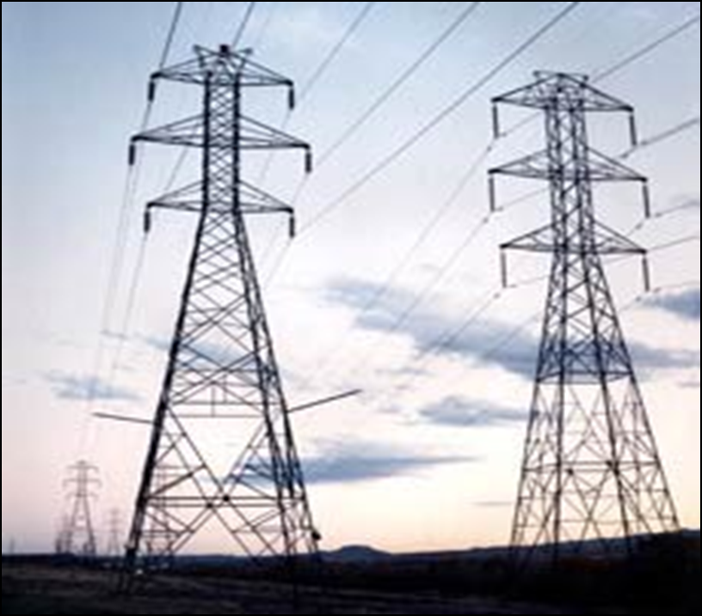
Kinetic energy: is the energy of motion
Electrical | Mechanical | Light | Sound | Thermal
Hot Chocolate

Slide 9
Group activity
Today you will be assigned to a group to work at a station. Each station will have a mystery box. The mystery box will have random items which you will use to describe various forms of energy and energy transformations.
Once you model the energy transformation to your group members you can add the model to the Energy Transformations sheet.
Let me show you how to do this.

Slide 10
Light bulb microwave demonstration
light bulb in microwave

Slide 11
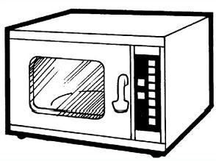


Energy Transformations sheet
Electrical
light, thermal
and sound energy

Slide 12
Group stations……
Now at your stations model as many forms of energy as you can. Make sure you add these to your “Energy Transformations” sheet.
We will come together as a class after 10 minutes. Your sheets will be collected at the end of the period.

Slide 13
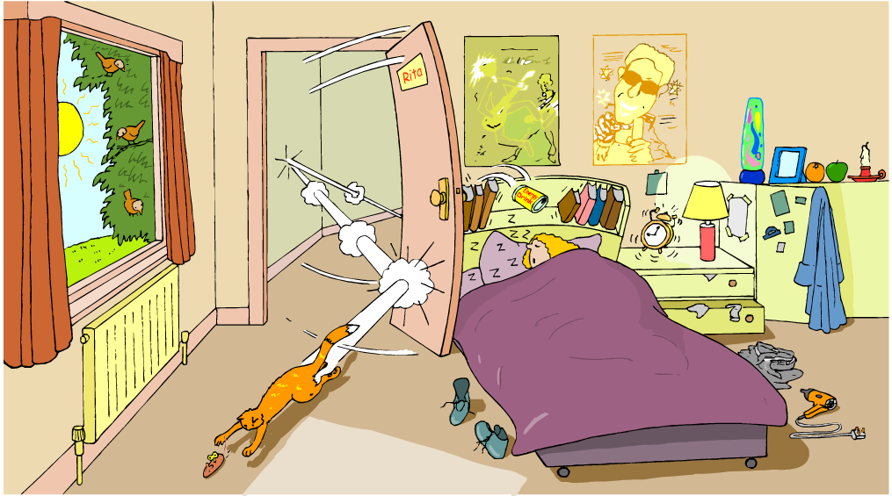
Describe all the forms of energy you see in the picture below.

Slide 14
Self Reflection questions:
Go to the microwave side & add a new understanding below your original answer. Do not erase your initial answer.
Go to the back of the paper and answer the Revised Thoughts Questions on the bottom:
What was surprising?
3. What did you already know but see in a new way?
4. What do you still need help with?
5. Score yourself on your understanding of energy transformations from 1 to 5, with 1 being the lowest.

Slide 15
Homework
Write a story to describe the “Energy Transformations” you experience in your daily life.
The story should be between 350- 500 words and include the following forms of energy: potential, chemical, kinetic, electrical, mechanical, sound, light and thermal.
Research another form of energy that you have not studied in class and include it in your story.
If you do not wish to write you can
videotape yourself or make an audio recording narrating the story with the energy forms mentioned above.
Make a comic and draw the various energy forms.
This assignment is due next Monday. Look at a story example on the next slide. It is about 90 words.

Slide 16
The alarm rings (chemical to sound and light energy). I get up and rush to get ready (chemical to mechanical energy). I prepare some scrambled eggs (electrical to thermal energy) and toast some bread (electrical to thermal and sound energy). I get on my bike and pedal fast (chemical to mechanical energy) to school. Just as I reach school the bell rings (electrical to sound energy). I see students talking and walking fast (chemical to mechanical and sound energy) to their classes. I reach the classroom all ready to learn about “Energy Transformations”.

Slide 17
Exit task
I want you to model mechanical energy transforming to sound energy using your hands.

Slide 18
Vocabulary
Transformations: change from one form to another
Energy: ability to do work.
Potential energy: stored energy.
Kinetic energy: energy of motion.
Thermal energy: is due to movement of molecules within an object.

