Slide 1
Salmon

Slide 2
Water quality macroinvertebrates local watershed Salmon dissection habitat analysis
Ecology

Slide 4
Use the resources provided to answer the questions on separate paper. (Pay attention to which questions match with the quiz.)
Directions

Slide 5
When you are done…
Make sure to turn in your work with your name and period on the paper with your teacher’s name. Answer with complete sentences. ☺

Slide 6
Water quality
Why do we perform the following tests: turbidity, dissolved oxygen, pH, temperature, nitrates, and phosphates? (Select the two best answers.)
1
A. Why would we perform these chemical water quality tests?
1. Turbidity –
2. pH –
3. Nitrite/Nitrate –
4. Dissolved Oxygen –
5. Temperature -
2
3
4
5

Slide 7
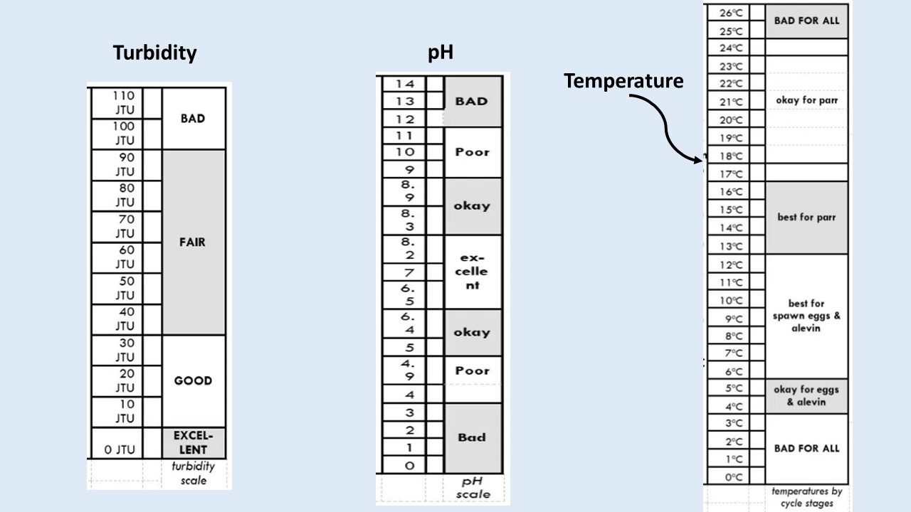
Water quality
Pick the two best pieces of evidence using the tables below to support the following claim: "Salmon can survive in the Green River."
B. Look at the tables, which levels would be best for the water quality and for the Salmon to live in a river?
Turbidity –
pH –
Temperature –

Slide 8
Macro- invertebrates
Which two macroinvertebrates (see diagram below) would indicate a healthy stream for salmon to live in?
C. How do Macroinvertebrates show water quality?

Slide 9
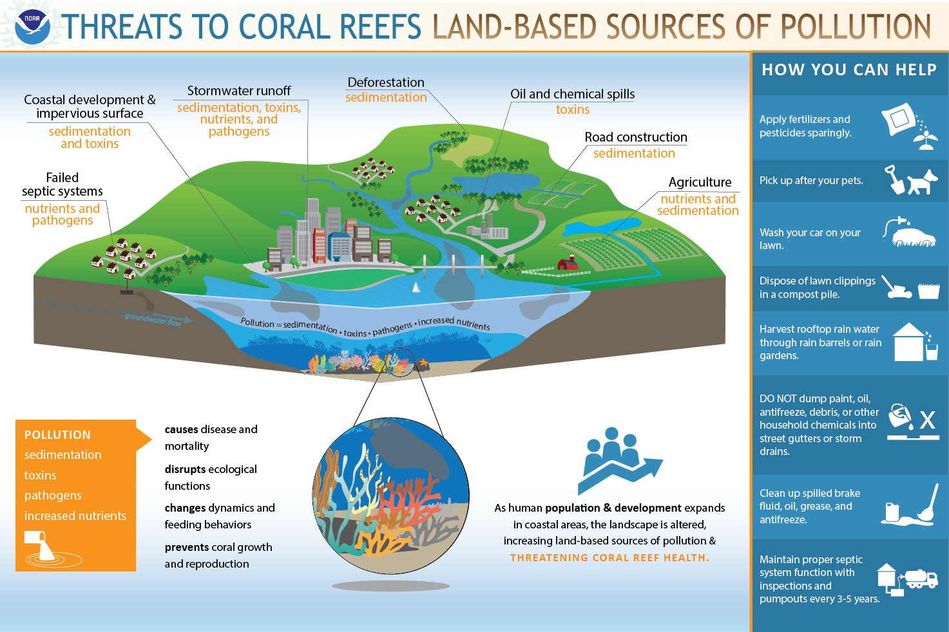
Water quality
Select two best answers The following are harmful to water quality.
D. What types of things are harmful to water quality in streams and rivers?

Slide 10
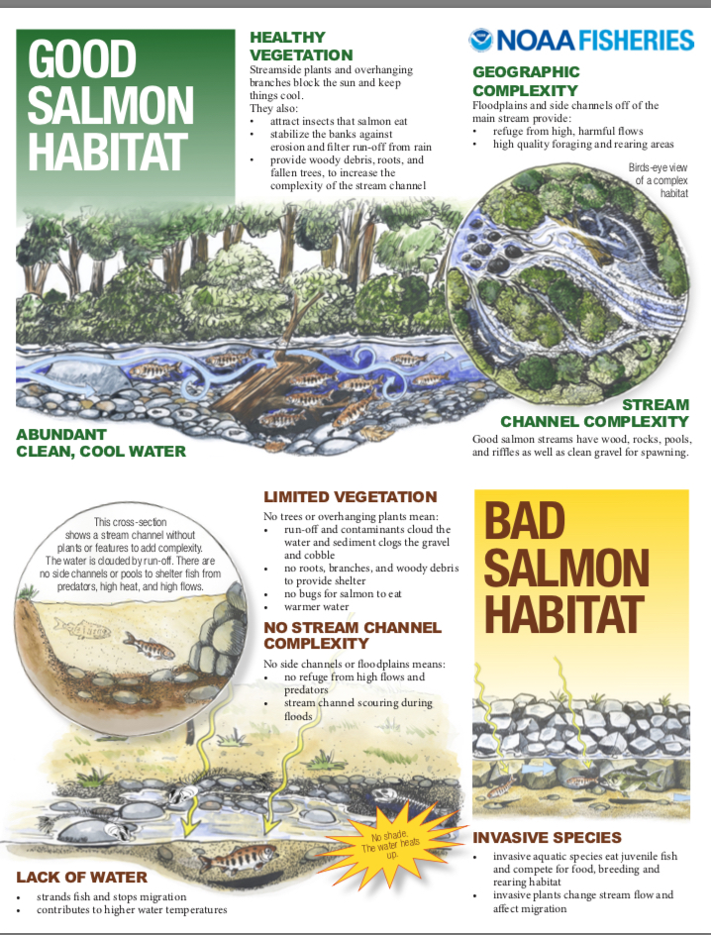
Stream Quality
Salmon need trees to provide shade to keep their eggs cool.
Tree roots cause erosion of stream banks, which help salmon live.
E. What do salmon need in their habitat to keep them alive?
F. What would cause salmon to not survive in the habitat?

Slide 11
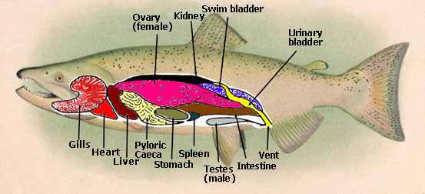
Salmon Anatomy
Salmon have the same reproductive organs as humans.
H. How are humans and salmon different?
I. How are humans and salmon the same?

Slide 12
Revised thoughts
For all students…
J. What was surprising?
K. What did you already know, but now see in a new way?
L. What do you still need help with?

