Slide 1

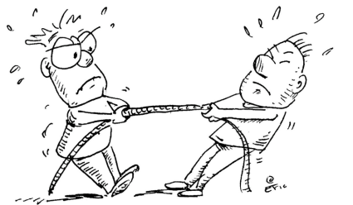
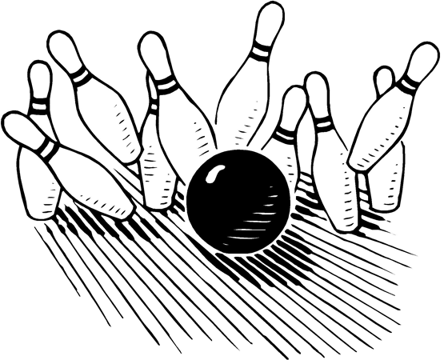
Thinking and Writing Like a Scientist:
Claims Evidence Reasoning - CER
Forces and Changes in Motion

Slide 2


Claim Evidence Reasoning
CER
Claim: (The answer to the question)
Evidence: (All the evidence you gathered from hands-on investigations, readings, videos, etc. )
The evidence includes the clues: the observations made and the data collected.
Reasoning: (Why you think the answer is correct.)
The reasoning explains how the evidence helps answer the question.
Notes:
CER Anchor Chart

Slide 3
Getting Started
First think about:
Use your resources:
What is a possible claim?
Where can you find your evidence?
What science words will
you want to include?
Where can you find science and other words to help you write?
Observations and data from hands-on activities
Videos
Reading passages
Science notebook
Your textbook
Classroom charts, word walls and bulletin boards
Notes:
CER anchor chart:
Ask students how they think they should get started.
Ask what is a possible claim?
Ask students what resources they have that will help them? If necessary, point out the anchor charts, word walls, and notes / activities in their science notebooks.
Say let’s see how a textbook page can help. See next slide.

Slide 4
Writing Scaffolds
Sentence Starters:
Writing Words:
My evidence to support my claim is…
The data…
According to the text…
On page ___, it said …
The author wrote…
For instance…
From the reading, I know that…
The graphic showed…
For example…
My evidence supports my claim because…
My claim is true because…
“Uncertainty” words:
usually, generally,
suggests, indicates
Sequencing words: first, second, third,
Next, last
Therefore
Because
If… Then…
However
Notes:
CER Anchor Charts

Slide 5
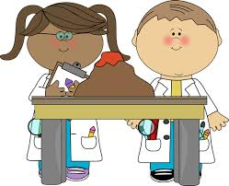
Claims Evidence Reasoning
Remember
When you make a scientific explanation, be sure to include:
1. The question you will answer.
The evidence that helps answer your question.
Your claim or what you think the answer is.
Your reasoning or why you think the answer is correct.
Notes:
CER anchor chart

Slide 6

Claim Evidence Reasoning (CER)
Assignment Part 1
Find force and motion investigation notes in your journal.
Watch the Discovery video: Friction
Do the Discovery Exploration: Changing the Speed of Motion.
Last read the articles: Zamboni and Now That’s Fast.
Be prepared to use evidence from what you investigated, read, heard and saw to support your answer to one of the following questions:
1. How does the force force of friction change the motion of an object?
2. How do different forces cause objects to change speed?
Notes:
Explore, Explain, Evaluate

Slide 7
Claim Evidence Reasoning (CER)
Assignment Part 2: Complete the following in your notebook:
My Question: (List question chosen.)
Evidence: (Record all the evidence you gathered from investigations, readings, and videos.)
Claim: (The answer to the question chosen.)
Reasoning: (Use the evidence to help explain why you think the answer is correct.)
Notes:
Explain, Evaluate

Slide 8
Claim Evidence Reasoning (CER)
Complete the Discovery Education Exploration: About Force
Then write a scientific explanation using a CER to answer one of the following questions:
What happens when two unequal forces push an object in the same direction?
What happens when two unequal forces push an object in opposite directions?
Notes:
Explore, Explain, Evaluate

Slide 9
Claim Evidence Reasoning (CER)
Complete the Discovery Education Virtual Lab: Pulling Your Weight.
Then write a scientific explanation using a CER to answer the following question:
Why is it harder to push objects across a carpet than it is to push objects across smooth tiled floors?
Notes:
Explore, Explain, Evaluate

Slide 10


Claim Evidence Reasoning (CER)
Use the Discovery Education resources listed below to answer the following question:
What happens to a ball thrown horizontally?
The Paris Gun (Reading Passage)
Gravity on Earth (Video Segment)
Next create an investigation to explore if the size or mass of a ball affects what happened to it when thrown horizontally.
Materials: several balls of different sizes and masses; balance, tape measure, an area that is a safe place to throw a ball
Create a problem statement and the experimental design to test whether mass or volume affect what happens to a ball thrown horizontally.
Complete the investigation. Does the data support your hypothesis? Write a scientific conclusion.
Notes:
Explore, Explain, Evaluate

Slide 11
Claim Evidence Reasoning (CER)
Use the Discovery Education resources listed below to answer one of the following questions:
What is needed to change the direction of a moving mass?
What happens to an object moving in one direction?
What happens to a ball thrown horizontally?
The Paris Gun (Reading Passage)
Forces on the Court (Reading Passage)
Let's Play Catch! (Reading Passage)
Principles of Motion (Video Segment)
Gravity on Earth (Video Segment)
Notes:
Explore, Explain, Evaluate

Slide 12
Discovery Education Resources
Forces and Motion
Newton’s First Law (video)
Friction (video)
Second Law of Motion (video)
Changing the Speed of Motion (Exploration)
About Force (Exploration)
Pulling Your Weight (Virtual Lab)
Notes:
More Resources

