Slide 1
GRAPHIC ORGANIZER:
INITIAL THOUGHTS Why Should I care? VIDEO EVIDENCE | INITIAL THOUGHTS Who Should I educate? VIDEO EVIDENCE | INITIAL THOUGHTS What should I say? VIDEO EVIDENCE

Slide 2
Who Should Care? About the Green/Duwamish Watershed, Puget Sound, Salmon, rainwater run-off?
Complete the top part of your graphic organizer as “Initial Thoughts” for the 3 questions in blue on the previous slide.

Slide 3
EQ: Who should be responsible for the pollution problem of the Green/Duwamish watershed?
LEARNING TARGET
SUCCESS CRITERIA
I can obtain information as evidence using systems thinking for the cause and effect of human impacts on watersheds.
Record notes in the summary table for the Frontline documentary on the Green Duwamish watershed.

Slide 4
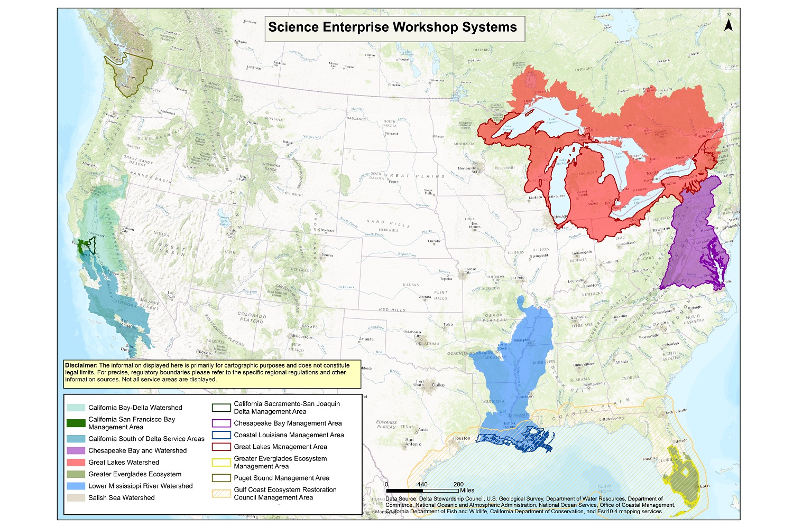
VIDEO RESOURCES
Review this watershed map to better understand the video.
As you watch the video, List any questions you may have or connections you may notice. (For future investigations).
*You should be stopping the video to look at the map

Slide 5
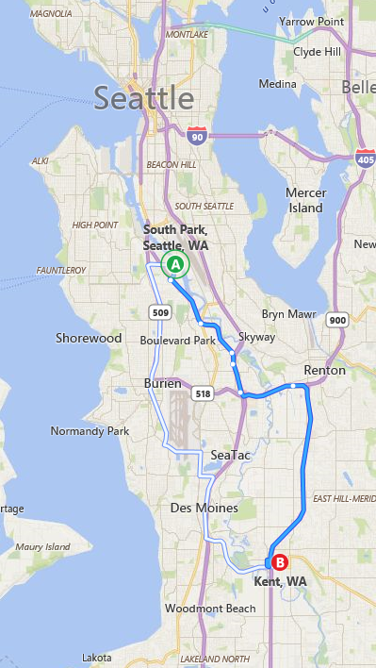
South Park in Seattle to Kent, WA *You should be stopping the video to look at the map
Zoomed in view of our local watershed (Green/Duwamish)

Slide 6
“Who Should Care?” Video Research
Watch the video starting about Chesapeake Bay and Puget Sound (click here)
DIRECTIONS:
Watch the first 15 minutes, then scroll ahead to the 44 minute mark and continue.
Complete the “Video Evidence” portion of the graphic organizer
*Pause the video as needed to look at the maps

Slide 7
REVISED THOUGHTS
What was surprising?
What did you already know but see in a new way?
What do you still need help with?

Slide 8
INITIAL THOUGHTS
Of all the things you learned about this year and its connection to the Puget Sound, what do you worry about the most? Explain why?

