Slide 1
HUMAN body system

Slide 2
INITIAL THOUGHTS (5 min)
How does the respiratory system depend on the nervous system or the circulatory system depend on the respiratory system?
What might happen to these body systems if one part of the whole network quits working?

Slide 3
Reasoning:
A body is a system of specialized organs that interact with each other and their subsystems to carry out the functions necessary for life.

Slide 4
OBJECTIVES
EQ: How does one body system affect one or more other body systems?
LT: Develop a model for the structure and function of the human body system
SC: Construct a human body systems flip book.

Slide 5
Agenda
Read the aligned power point and fill out your model
Present to the group each model and fill out one model for each system
Complete graphic organizer.

Slide 6
Create a Data Table Title Bar: (2 min)
System Name | Function | Major organs | Interacts with which systems

Slide 7
GrOUP ASSIGNMENTS Instructions (20 sec)
SETTING UP THE GROUP:
In your groups, assign who is in charge of which body sub-system..
Partner 1 “Respiratory System”
Partner 2 “Circulatory System”
Partner 3 “Digestive System”
Partner 4 “Nervous System”

Slide 8
Body Systems FLIP BOOK Instructions
Flip books show how sub-systems work together.
SETTING UP THE BOOK: (2 min)
Put your name on the back of your book.
Label Page 1 “Respiratory System”
Label Page 2 “Circulatory System”
Label Page 3 “Digestive System”
Label Page 4 “Nervous System”

Slide 9
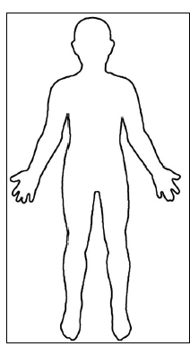
NEXT STEPS OVERVIEW
Research your assigned system.
Complete the data table for your system.
Draw/label your system on the flip book.
Teach your group about your system.
Listen to your partners teach about their system & complete your data table.
Copy their system’s flip book page.

Slide 10
Body Systems FLIP BOOK Instructions
GATHERING INFORMATION INSTRUCTIONS (20 min)
Use your assigned PPT to identify major organs that exist in your system & write them on the data table.
On the data table, record, the “Structure & Function” of the system.
Also record what other systems it interacts with.
Draw/Label the organs on your flip book page.
Prepare to teach this to your team so everyone can complete their data table and flip book

Slide 11
TEACHING EACH OTHER (5 min each)
Complete the data table as your group member presents.
Complete the flip book page for each presenter
Think about:
What major organs are present in each system.
How does each system serve your body?
How does each system work with others?

