Slide 1
Note Taking Strategies

Slide 2
LT: Obtain information for carrying out investigations
SC: Complete a T-chart for notetaking strategies

Slide 3
INITIAL THOUGHTS (IT)
How can we collect relevant information without copying everything we read, watch or hear?
Notes:
What does relevant mean? Important, on topic, related…

Slide 4
Table Partner Brainstorm (2 min)
With your elbow partner, create a list of all the “Benefits” of taking notes… (This will be shared out)

Slide 5
Benefits of Taking Notes (add to your notes)
Evidence Reasoning
You can read it again in your own words (Makes it Personal)
You don’t have to memorize everything (Simplifies)
It gives you something to look at later (Easy Access)
It helps you collect only the “Useful” Information (Filters)
Graphic Organizers are helpful (Keeps you organized)
SAVES YOU TIME AND STRESS LATER!!!!!
Notes:
Students copy in science notebook, page 5

Slide 6
Make a T-Chart: Add this to your notebook
NOTE TAKING STRATEGIES BENEFITS OF THE STRATEGY
Cornell Notes
T-Chart
Venn Diagram
Data Table
Concept Map
Bullet Points
KWL
Annotations
Key
Thought Bubble
Questions Answered
Compare Differences
Compare & Contrast
Collect/Record Info
Brain dump – personal thinking
Quickly Organize Key Points
Metacognition/Reflection
Finding CER: underlining, highlighting, important details
Organizing/Modeling
Personalize Thinking
Notes:
Students copy on right side, page 5.

Slide 7
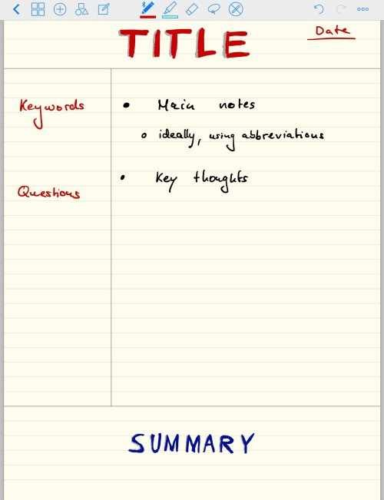
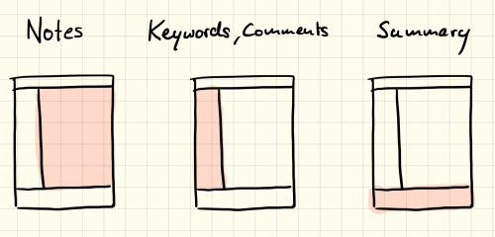
Cornell Notes
Notes:
Share briefly how cornell notes work. Some students have used it, many not.

Slide 8
Let’s check out Sustainability Ambassadors for Note-taking Strategies
Type in “sustainability ambassadors note taking”
Bookmark this page in Favorites List or on Bookmark Toolbar
When you click on each link it will download a template of a strategy onto your computer, which you can then review.

Slide 9
REVISED THOUGHTS (RT)
What was surprising?
What did you already know but see in a new way?
What do you still need help with? If you don’t need help, write a question about this topic?

