Slide 1
Lava Lamp
Matter vs Energy

Slide 2
Initial Thoughts (5 min)
What is matter?
How is energy different than matter?
IT

Slide 3
EQ: What is the difference between matter & energy?
Learning Target:
I can draw a model to show my understanding of the structure and function of a system.
Success Criteria:
I can label the inputs and outputs of matter and energy in a lava lamp.

Slide 4
Draw a model of this lava lamp… (2 min)
… after we watch some lava lamps in action on this
Lava Lamp Video

Slide 5
Class Brainstorm: What information should be in a model drawing? (1 min)
Write down in your notebook the types of information you look for when reading diagrams and models.

Slide 6
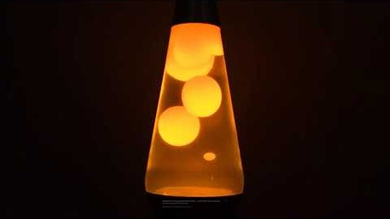
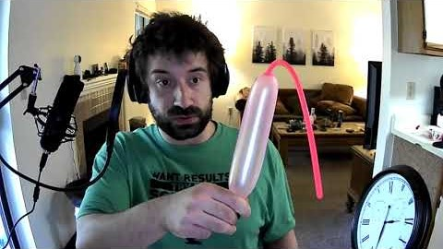
Balloon Demo: What is an Input/Output?
Class Discussion
I am going to blow up a balloon (Demo). What was going into the balloon?
My breath. Is anything going into the balloon now?
No. Why not?
Because it is “Closed.” Can gas, liquid, or solids get in right now?
No. Not unless I leave it open.
What can we label as an “Input”?
What can we label as an “Output”?

Slide 7
Draw a model of the balloon… (2 min)
Make sure to label “Inputs” & “Outputs” in your balloon model

Slide 8
Balloon Demo: What is an Input/Output?
Class Discussion Continued
Let’s think about the balloon again. What will happen if I OPEN my fingers?
The gas will leave?
Can we call that an “Output?”
Was it matter or energy that was the output?
Why was it matter?
Because it was a gas. To be matter it must be a solid liquid or gas.
So what is our electrical cord for the lamp?
It is a solid. Is the cord an input to the lamp?
No, it is only connected.
So what is actually going into the lamp?
Electricity. BUT wait!!!! IS electricity and matter the same thing?
(Some say yes & some say no)…WHAT DO YOU THINK???

Slide 9
Lava Lamp: What is matter? & What is energy?
Class Discussion
What is currently going into the lava lamp?
What is coming out of the lava lamp
Is there any “Solid, Liquid, or Gas” going into the lava lamp?
Is there any “Solid, Liquid, or Gas” coming out of the lava lamp?
Is there any matter inputs or outputs?
NO, What is going in?
Electricity… What is electricity?
Energy… Are energy and matter the same?

Slide 10
EQ: What is the difference between matter & energy?
Learning Target:
I can draw a model to show my understanding of the structure and function of a system.
Success Criteria:
I can label the inputs and outputs of matter and energy in a lava lamp.

Slide 11
When looking at the lava lamp… (2 min)
What are the “Inputs” to the lava lamp systems?
What are the “Outputs” from the lava lamp systems?
What symbols could we use to show inputs/outputs on a model?
What could we use on our model to keep it organized?

Slide 12
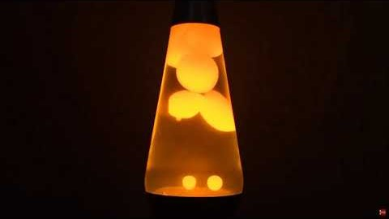
Lava Lamp: What is Matter? What is Energy?
Class Discussion Continued
What is an “Output” of the lamp?
Light and Heat. Are these outputs matter?
No. Why not? Can we weigh light or heat on a scale or balance? Can I hold light in my hand?
What is heat & light?
Just like electricity, it is also energy.
Think about this… Do you have feelings? Can we weigh them? Can we measure the space they take up? What about thoughts? If we can’t weigh them or measure them, does that mean they’re not real?
Our thoughts and feelings are very real. But they need our brain and bodies to work. This is a metaphor for energy.
Energy can pass through matter (Like the electrical cord) and it can be stored in matter (Like a battery). Energy needs matter to work just like our memories need our brains to be stored.

Slide 13
Draw a new iteration of your Lava Lamp model… (2 min)
Make sure to draw a legend or key on your model
Make sure to label “Inputs” & “Outputs” in your model
Make sure to label each of the Inputs & Outputs as energy or matter

Slide 14
REVISED THOUGHTS: Matter & Energy
What was surprising?
What did you already know but see in a new way?
What do you still need help with?
RT

Slide 15
EQ: What is the difference between matter & energy?
Learning Target:
I can draw a model to show my understanding of the structure and function of a system.
Success Criteria:
I can label the inputs and outputs of matter and energy in a lava lamp.

