Slide 1
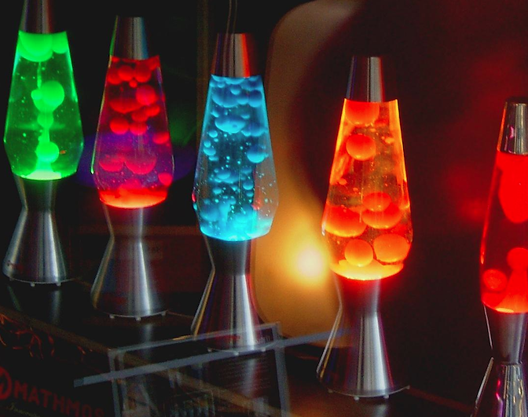
Lava Lamp: Density of Matter

Slide 2
Look & Think… (1 minute)
Look at the picture and try to figure out why it looks like this?
Why aren’t the liquids and solids mixing?

Slide 3
Initial Thoughts Choose 2
IT
ANSWER THESE QUESTIONS IN YOUR SCIENCE NOTEBOOK:
When have you heard the word “Density” before?
Why does the lava (wax) move up and down?
What happens to the lava when the lamp is not turned on?
Lava Lamp Light

Slide 4
EQ: How can we use models to help us learn and solve problems?
LEARNING GOALS
LT: I can construct models to show how systems work.
SC: Revise the lava lamp model to include the phenomenon of “density.”

Slide 5
REMEMBER: COMMUNITY OF SCIENCE SAYS… “Models are never finished… They are our best understanding so far.”
HOW DOES YOUR MODEL EXPLAIN THE PHENOMENON?
Might include things we cannot see
Must include rules

Slide 6
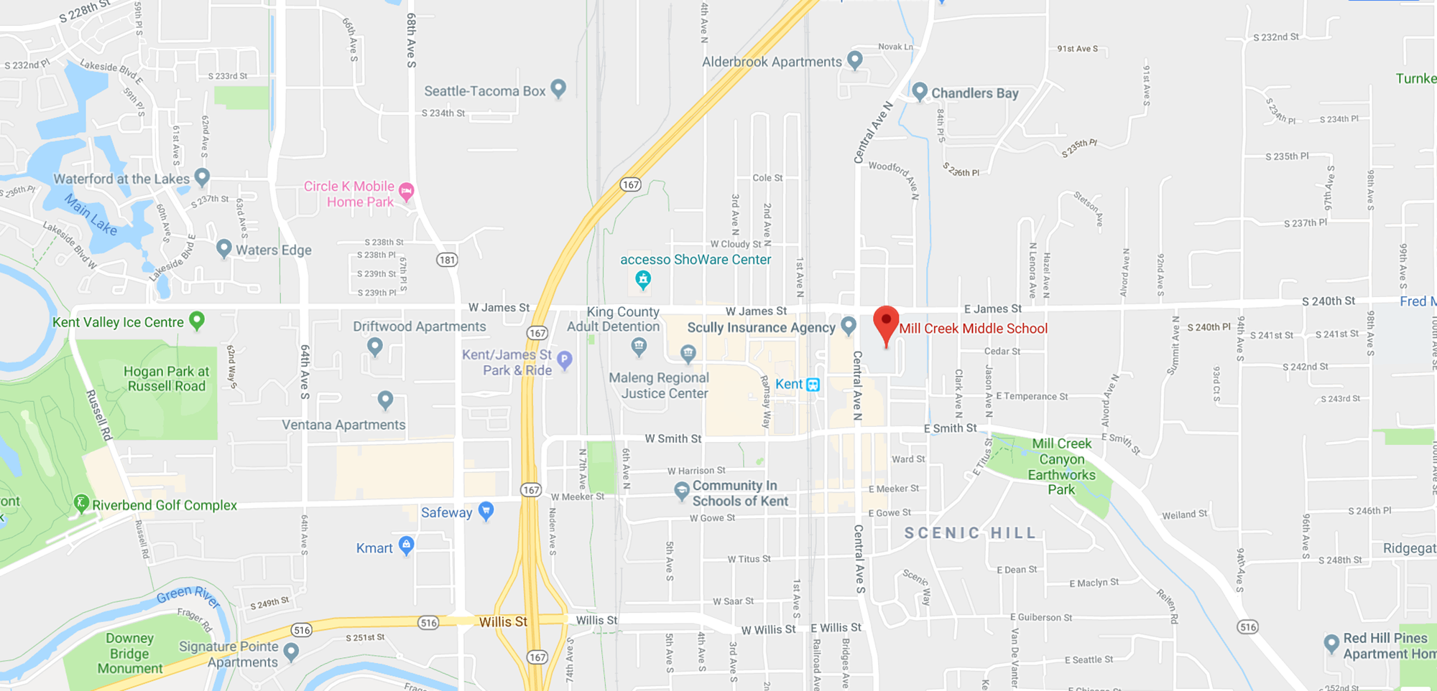
Do maps count as models?
Use the “Scientific Models” Rules to test if a map works as a model.
Can a map help you answer questions when you’re lost?
Does a map include things you may not normally see?
Does it use a key to help you understand how the model works?
Can it help you make predictions?
Is a map revisable when new roads are added?
Are maps public?
Is a map a model?

Slide 7
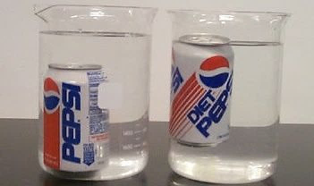
In Your Notebook: Write Observations About the Image Soda
What is the difference between these two cans of soda?
Which has high density?
How is this like the lava lamp?

Slide 8
Class Discussion: Sink or float?
What is the difference between these two cans of soda?
Which has high density?
How is this like the lava lamps?
Objects that have high density sink
Objects with low density float
(If we have time after we write Revised Thoughts, we will watch this video.)
Follow this link to watch the
SESAME STREET SCIENCE VIDEO
Make predictions about what will sink or float!

Slide 9
What is happening in the picture?
I shook up the bottle and waited 10 seconds then took a picture. I then took new pictures every 10 seconds until the beads ended up in the middle.
Which beads are most dense? How do you know that?
How many liquids must be in the bottle?
The answer is 2. Water is on the bottom when it is done separating. Medical Alcohol is on the top.

Slide 10
Density explained
The reason why pictures two and 3 show liquid in the middle is because when I shook the bottle the water and alcohol mixed. The beads are solid so they were able to separate faster but the liquids took a little more time to separate.
Based on the last picture, we know the water at the bottom has the highest density, then the blue beads. The white beads have the third highest density and the alcohol on the top has the lowest density.

Slide 11
Success Criteria: Revise the lava lamp model to include the phenomenon of “density.”
How can we draw density for the wax moving up and down in a model? (Brainstorm ideas).

Slide 12
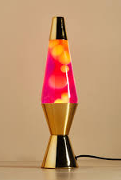
Discussion: How is “Density” working in the lava lamp?
Where is it hottest in the lava lamp?
Next to the light bulb.
Where is it coldest in the lava lamp?
At the top.
When matter is hot the molecules “Expand” (Spread apart) This makes the lava wax less dense (So it floats)
When matter is cold the molecules “Condense” (Come closer together) This makes the lava wax more dense (So it sinks)

Slide 13
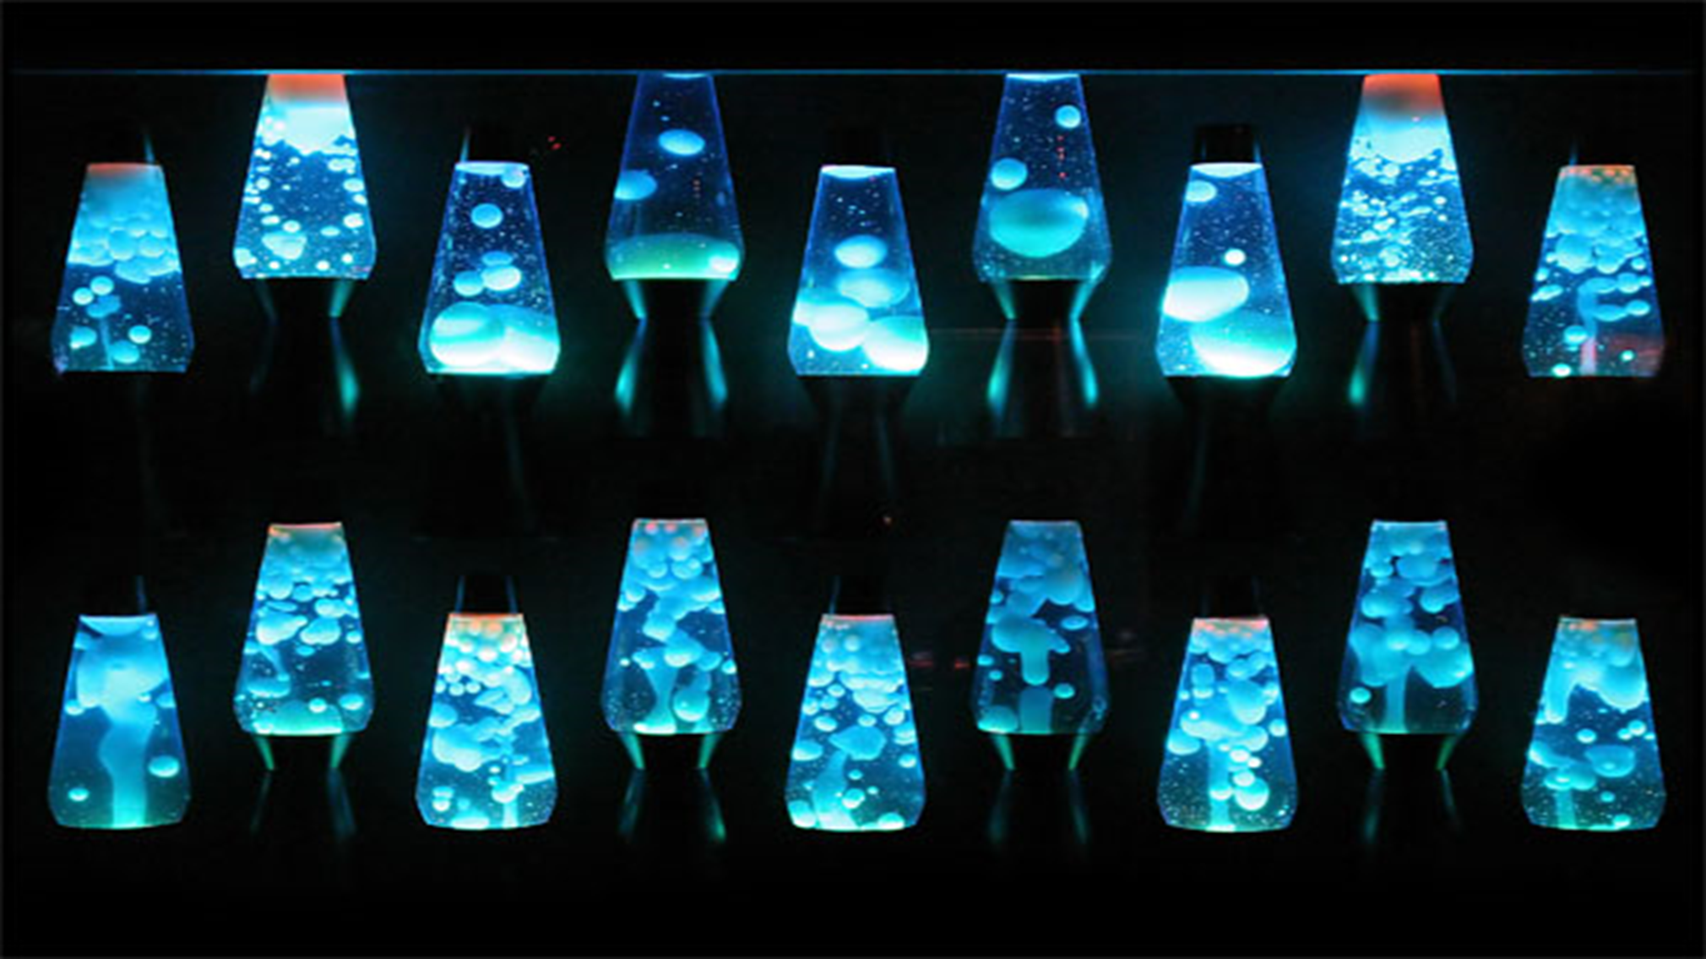
USING RULES of MODELS (Again)
Draw a new iteration of the Lava Lamp model to include the “Rule of Density”. (3 min)

Slide 14
Scientific Models
Did you make a key or legend?
Did you include arrows to represent inputs/outputs for matter AND energy?
Did your model represent the rules of density?
Show on your model what is more dense and less dense.
Is it a model or a diagram? Use the “Models Checklist on slide 5 to check!!!!!!
1
2
3
4
5

Slide 15
REVISED THOUGHTS: Rules of Models & Density
RT
What was surprising?
What did you already know but see in a new way?
What do you still need help with?

Slide 16
EQ: How can we use models to help us learn and solve problems?
LEARNING GOALS
LT: I can construct models to show how systems work.
SC: Revise the lava lamp model to include the phenomenon of “density.”

Slide 17
EXTENSION: Cookie Monster Explains Science
(If we have time after we write Revised Thoughts, we will watch this video.)
Follow this link to watch the
SESAME STREET SCIENCE VIDEO
Make predictions about what will sink or float!

