Slide 1
Lava Lamp ENERGY
TRANSFERS & TRANSFORMATIONS

Slide 2
Initial Thoughts Choose 2 for 5 minutes of writing
What is an energy transfer?
What is an energy transformation?
Describe all of the energy interactions in the lava lamp.

Slide 3
LEARNING TARGETS
EQ: How can we use models to help us learn and solve problems?
LT: I can create a model to show my understanding of the functions of energy transfers in the system.
SC: I can edit my model to include energy transfers and transformations.

Slide 4
Class Discussion
How are energy transfers different than energy transformations?
Is it any different for different types of energy? For example is electricity transfers different than heat transfers?
Let’s watch this video to understand the energy transfer called “Convection” (Write Notes) ONLY WATCH UNTIL 2:16 min.
ENERGY VIDEO LINK

Slide 5
Find examples in the picture of the following types of energy: Electrical Chemical Sound Thermal (Heat) Mechanical Ultra Violet Kinetic Potential

Slide 6
Describe how the types of energy can either TRANSFER or TRANSFORM.

Slide 7
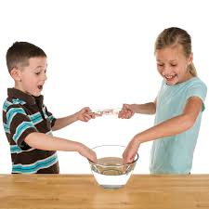
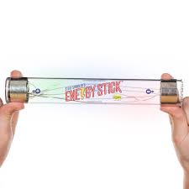
Energy Stick: WHAT IS HAPPENING?
Watch the video link below and think about how you could model what is happening
Energy Stick Video Link

Slide 8
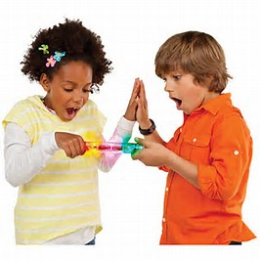
Energy Stick Demonstration: 3 Min
IN YOUR NOTEBOOK:
What would be an example of an energy transfer?
What would be an example of an energy transformation?
Was the energy stick activity a demonstration of an “Energy Transfer” or “Transformation?” Why/Why not?

Slide 9
LEARNING TARGETS
EQ: How can we use models to help us learn and solve problems?
LT: I can create a model to show my understanding of the functions of energy transfers in the system.
SC: I can edit my model to include energy transfers and transformations.

Slide 10
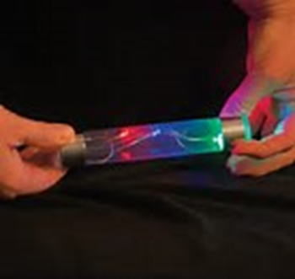
Energy Stick Demonstration
ADD TO YOUR NOTEBOOK:
DRAW A MODEL OF THE ENERGY STICK DEMO.
Here’s a VIDEO LINK to help you
ANOTHER VIDEO LINK showing a different energy stick demo (Watch first 1:51 min)

Slide 11
What do we have left to do to meet our Success Criteria?
SC: I can edit my model to include energy transfers and transformations.
WE HAVE TO DRAW A NEW MODEL!!!!!!

Slide 12
What is missing in this model???

Slide 13
Our 4th Lava Lamp Model Must Include:
A Key or Legend
Labels for all parts
Representation for Matter
Representation for Energy
Arrows showing Matter Inputs and Matter Outputs (Only if available)
Arrows showing Energy Inputs and Energy Outputs
Representation of how Density is working in the model
Representation for how Energy Transfers in the model
Representation for where Energy Transforms in the model

Slide 14
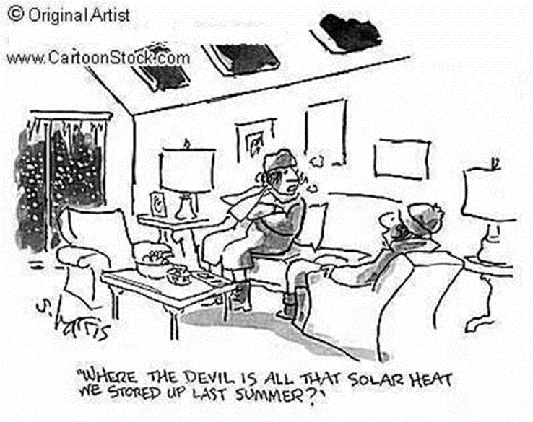
REVISED THOUGHTS: Energy Transfers/Transformations
What was surprising?
What did you already know but see in a new way?
What do you still need help with?

Slide 15
LEARNING TARGETS
EQ: How can we use models to help us learn and solve problems?
LT: I can create a model to show my understanding of the functions of energy transfers in the system.
SC: I can edit my model to include energy transfers and transformations.

Slide 16
(IN CLASS DEMO) Energy Stick: WHAT IS HAPPENING?
“We need 2 volunteers.”
“Now hold hands. Here, hold this stick.”
“Wait, what happened. Well that was cool.”
“Can we get a few more people to join?”
“How are they doing it?”
“Well, let’s spread out. You, put your hand on their shoulder.”
“Okay team, try it again. Wait, it’s not working.”
“Okay, Okay, Okay, spread out more… Just hold hands so you have more room.”
“Well, cool its working again. Let me in… I’m going to put my hands on their shoulders.”
“Wait, it’s not working anymore. Well, let’s try something else then…. Can you put one finger in the water bowl?”
“Well you too, put a finger in the water bowl as well…”
“Well let me try.”

