Slide 1
NEUROSCIENCE 101
DAY 2

Slide 2
How Do Neurons Communicate?
Learning Target
Success Criteria
I can communicate information about the structure and function of the nervous system.
Compare the brain with a mystery object using a T-chart or Venn Diagram.

Slide 3
Action Potential Game (15 min)
Arrange students into two opposing teams standing shoulder to shoulder as a “Neural Pathway”
Have one hand represent their “Dendrites” receiving the message and the other hand represent their “Pre-synaptic Terminal/Axon Terminal” sending the message
Place a small object in each person’s “Axon Terminal” to represent “Neurotransmitters”
4. The last person of each chain should have a bell to ring
5. When they ring the bell it represents the message of the “Action Potential being received at the end of the path.”
6. The teacher will start the round by making a noise to signal a “Sensory input to be transmitted to the brain.”
Rules: If dropped, start over. Hands cannot touch

Slide 4
NEURON ROPE MODEL… (5-7 Min)
Several students are needed to each hold a short rope piece representing the “Dendrites” while one student holds the “Cell Body/Soma” (plastic container to which dendrites are attached).
One student should hold the “Synaptic Terminal” (plastic container with balls). Make sure the person holding container keeps their hands away from the place the “Axon” (Rope) attaches.
One student should hold some “Molecules of Neurotransmitters” (some of the plastic balls) near the students who are the dendrites.
One student should hold the (pool float) to represent the energy transferring through the neuron “Action Potential.”
The student near dendrites gently tosses the plastic balls to the dendrites to signal a sensory input. They try to catch the balls.
The person holding the pool float forcefully pushes the float along the rope in one swift push sending an “Electrical Pulse” and triggering a “Electro-Chemical Transformation at the Synapse.”
Other Neurons use their dendrites to catch neurotransmitters
Notes:
o

Slide 5
Stroop Effect - 1

Slide 6
Stroop Effect - 2
RED GREEN BLUE BLACK
PINK ORANGE RED BLUE
BLUE BLACK PINK GREEN
RED GREEN BLUE YELLOW
BLUE RED GREEN BLACK

Slide 7
Stroop Effect - 3
RED GREEN BLUE BLACK
PINK ORANGE RED BLUE
BLUE BLACK PINK RED
RED GREEN BLUE BLACK
BLUE RED GREEN PINK

Slide 8
Stroop Effect - 4
DER NEERG EULB KCALB
KNIP EGNARO DER EULB
EULB KCALB KNIP DER
DER NEERG EULB KCALB
EULB DER NEERG KNIP

Slide 9
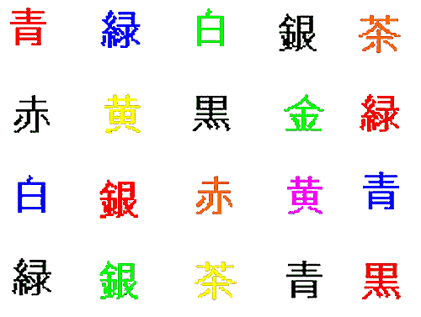
Stroop Effect - 5

Slide 10
Color Aftereffects

Slide 11
PRIVATE REASONING: Discussion Protocol Prep (3 min)
Question: What does it mean if a team drops their “neurotransmitters” & what is the significance of the message traveling quickly or slowly?

Slide 12
TEAM WORK… Discussion Protocol
Choose a group leader (Reporter)
30 sec Each: Read what you wrote to your group
30 sec Private Reasoning: to think of 1 example of anything that could cause the nervous system to speed up or slow down the “Sending and receiving” of nerve impulses?
20 sec Each: Pitch example to the group
10 sec Team Vote: On the count of 3 point to the one you want the leader to report to the class
EVERYONE STAND UP WHEN READY!!!!

Slide 13
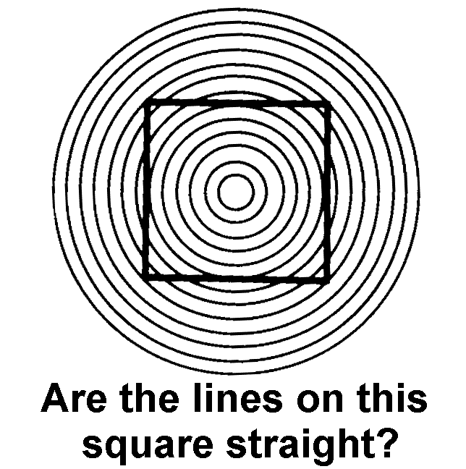
Do your eyes fool your brain?

Slide 14
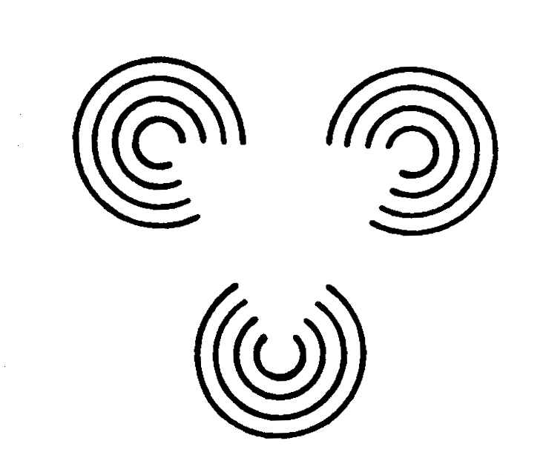
Do your eyes fool your brain?
Do you see a triangle?

Slide 15
Do your eyes fool your brain?
B
C
Which line does “A” match up with?
A

Slide 16
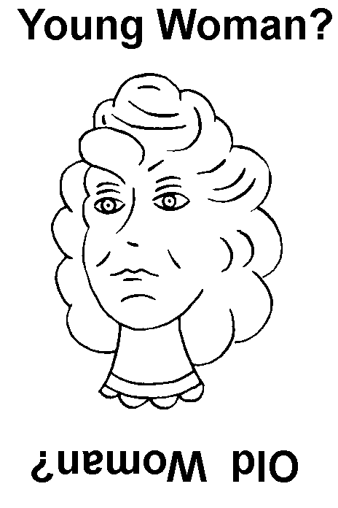
It depends on how you look at it!

Slide 17
EXPECTATIONS Influence Our Perceptions
What do these two lines say?
L J QVF SGUQQI
L J QVF SGUQQI
NFUPQSGIFNGF JS EUN
NFUPQSGIFNGF JS EUN
Are you sure?

Slide 18
How is the brain similar or different to the object?
Brain vs. Object
Similar Different
EXIT TICKET:
Use the object provided by your teacher to complete a new metaphor T-chart.
Notes:
If students need a few examples to help them get started, some sample Brain Metaphors have
been provided below.
The Brain is a… Because it…
Spider web…is delicate, minimal, hypersensitive, and connects many things. It responds instantly and simultaneously to outside events.
Prism …breaks white light (seemingly one thing) into many colors.
Lens …magnifies and concentrates energy to an intense point (focus).
Lamp …allows you to see things better.
Spaceship …can orbit the whole world and travel to other worlds (imagination!).
Map …has different geographical features each with unique characteristics.
Atlas …is a collection of maps (of all scales and types).
Mirror …can see things as others see it and see other things and oneself from all angles.
Tree …has branches that diverge and converge.
River …has many tributaries that branch.
Bunch of toys …must be played with to learn all sorts of things.
A friend …does things together, shares, and compares knowledge.
Factory …manufactures things.
Toolbox …can be used in all sorts of ways to make all sorts of things.
Thundercloud …accumulates and then suddenly and briefly releases great energy.
Snowflake or Crystal…grows symmetrically from center point to “huge” size.
Cookbook …contains recipes for making all sorts of things.
Music or Dance …orchestrates movement of things, ideas, or emotions.

