Slide 1
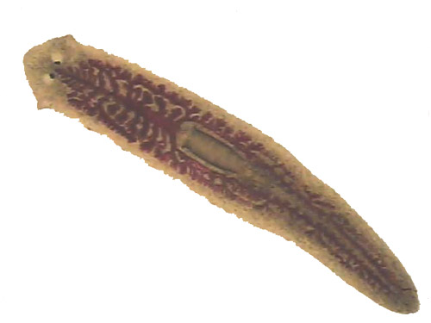
PLANARIA REGENERATION
How does the chemical properties have an affect on cell regeneration?

Slide 2
INITIAL THOUGHTS
What is a model organism?
Why do scientist prefer to test on planaria instead of or rats when studying regeneration or the healing process?
Why can’t humans regenerate an arm?

Slide 3
DAY 1. Lab Prep…
Today you will be working with your team to conduct research about planaria and better prepare for tomorrow’s lab.

Slide 4
EQ: What makes STEM cells so important?
LEARNING TARGET
SUCCESS CRITERIA
I can obtain information about the biology of planaria.
Annotate the planaria regeneration article and completing Day 1 lab research.

Slide 5
Complete the following research tasks & take notes for your work to reference later
Read & annotate the Regeneration Lab Article from Neuroseeds
Watch this mini-documentary on planaria use in labs
Watch this Sci-Show clip on regeneration
Find a different video or article on planaria or regeneration
DO YOU HAVE ENOUGH INFORMATION TO COMFORTABLY COMPLETE THE LAB OR WRITE A LAB REPORT?
NO= Research more
YES= Complete your LT checks and proceed to review the lab procedures

Slide 6
PART 1. Understanding the lab….
As a team open your lab binders to “PLANARIA REGENERATION LAB”
Review the materials & procedures
Look at Step 5: What is a 1%, 5%, 10% Solution (Watch this video link to better understand serial dilutions and concentrations)

Slide 7
PART 2. Prepare your lab worksheet…
Question/Statement:
Plants have chemical (medicinal) properties that can have an effect on cell regeneration in animals.
As a team, identify variables, write a lab title, and write your hypothesis.
Raise your hand for your teacher to check your work and assign you a group chemical & job.

Slide 8
PART 3. Prepare for the lab…
1. Record the chemical assigned by your teacher
Ginger infusion
Ginko Infusion
Tumeric Infusion
Chamomile Infusion
Plantain Infusion
Cayenne Infusion
Tobacco Infusion
Ginger Decoction
Comfrey Decoction
Tobacco Decoction
Cayenne Decoction
Centella Decoction
Valerian Decoction
St. John’s Wort Decoction
2. Circle the job assigned by your teacher and read the responsibilities of that job. (Discuss as a group if you are confused).

Slide 9
DAY 2. Lab Day…
Today you will be completing the planaria lab with your assigned team in order to record data for a minimum of 3 days…
To save materials, we will share a water control petri dish. I will put it on the document camera to see.

Slide 10
EQ: What makes STEM cells so important?
LEARNING TARGET
SUCCESS CRITERIA
I can conduct an investigation for the function of planarian cell growth.
Compare hypothesis with lab group and proceed with lab following instructions.

Slide 11
PART 1. FOLLOW THE STEPS BELOW IN ORDER!!!
Observer: Make sure everyone is wearing goggles
Recorder: See the slide example images for how to label medicine cups and petri dishes (step #2 & #3 in the lab instructions)
(Use sharpie on medicine cup and label tape on petri dish)
Solutions Master: See the slide instructions to replace steps 5a, 5b, 5c, 5d
Surgeon: See step #6, #7, & #8 in the lab instructions
Surgeon: See step #9 to REPEAT STEPS 6-7 for other planaria in petri dish
Surgeon: See step #10 in the lab instructions
Observer: See step #11 in the lab instructions
Recorder: See next slide to complete step #12

Slide 12
“Recorder” Examples of labeling
Preparing Medicine Cups
Preparing Petri Dishes

Slide 13
“Solution Master”
Preparing the 10% Solution
Preparing the 5% & 1% Solution
Add 18 mL of conditioned water into the graduated cylinder
Add 2 mL of plant chemical to the same graduated cylinder so it is now 20 mL total
Stir with pipette & transfer 10 mL from the graduated cylinder to the 10% medicine cup
Transfer 5 mL of the remaining solution from the graduated cylinder to the 5% medicine cup
Transfer 1 mL of the remaining solution from the graduated cylinder to the 1% medicine cup
Add 5 mL of conditioned H20 to the 5% medicine cup
Add 9 mL of conditioned H20 to the 1 % medicine cup

Slide 14
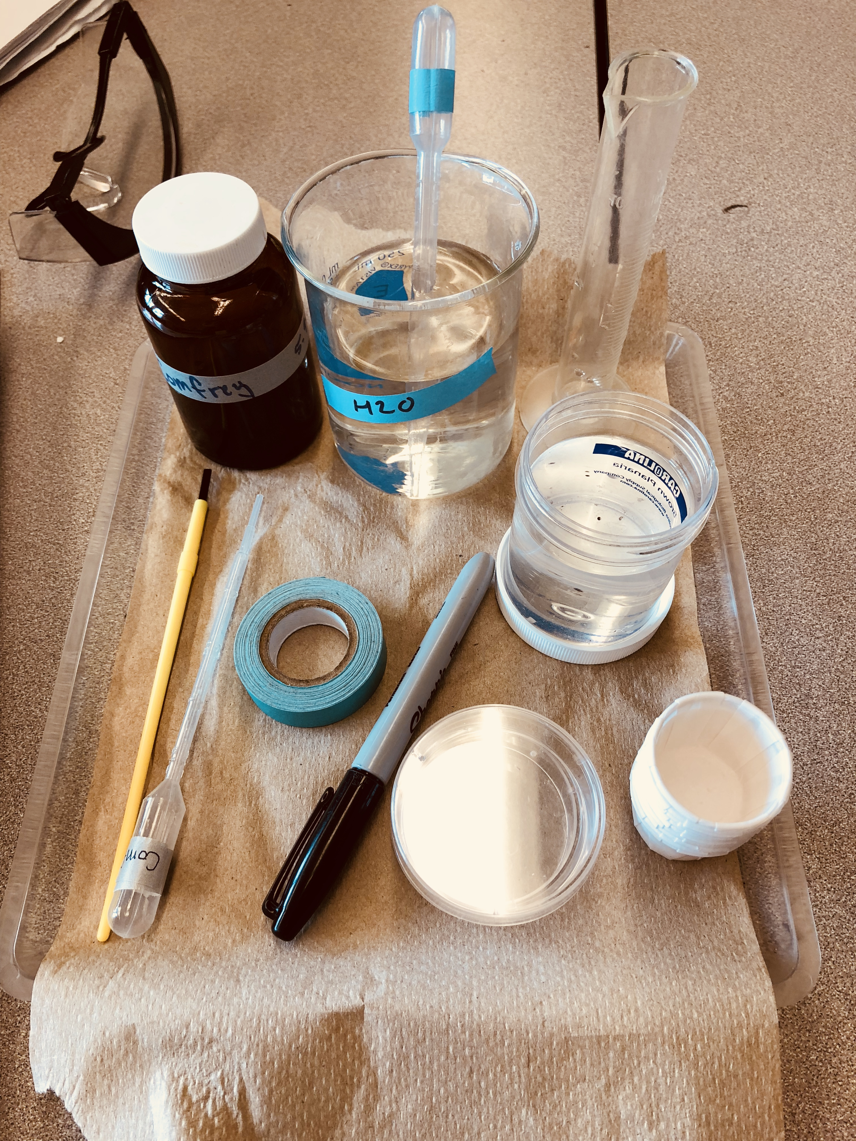
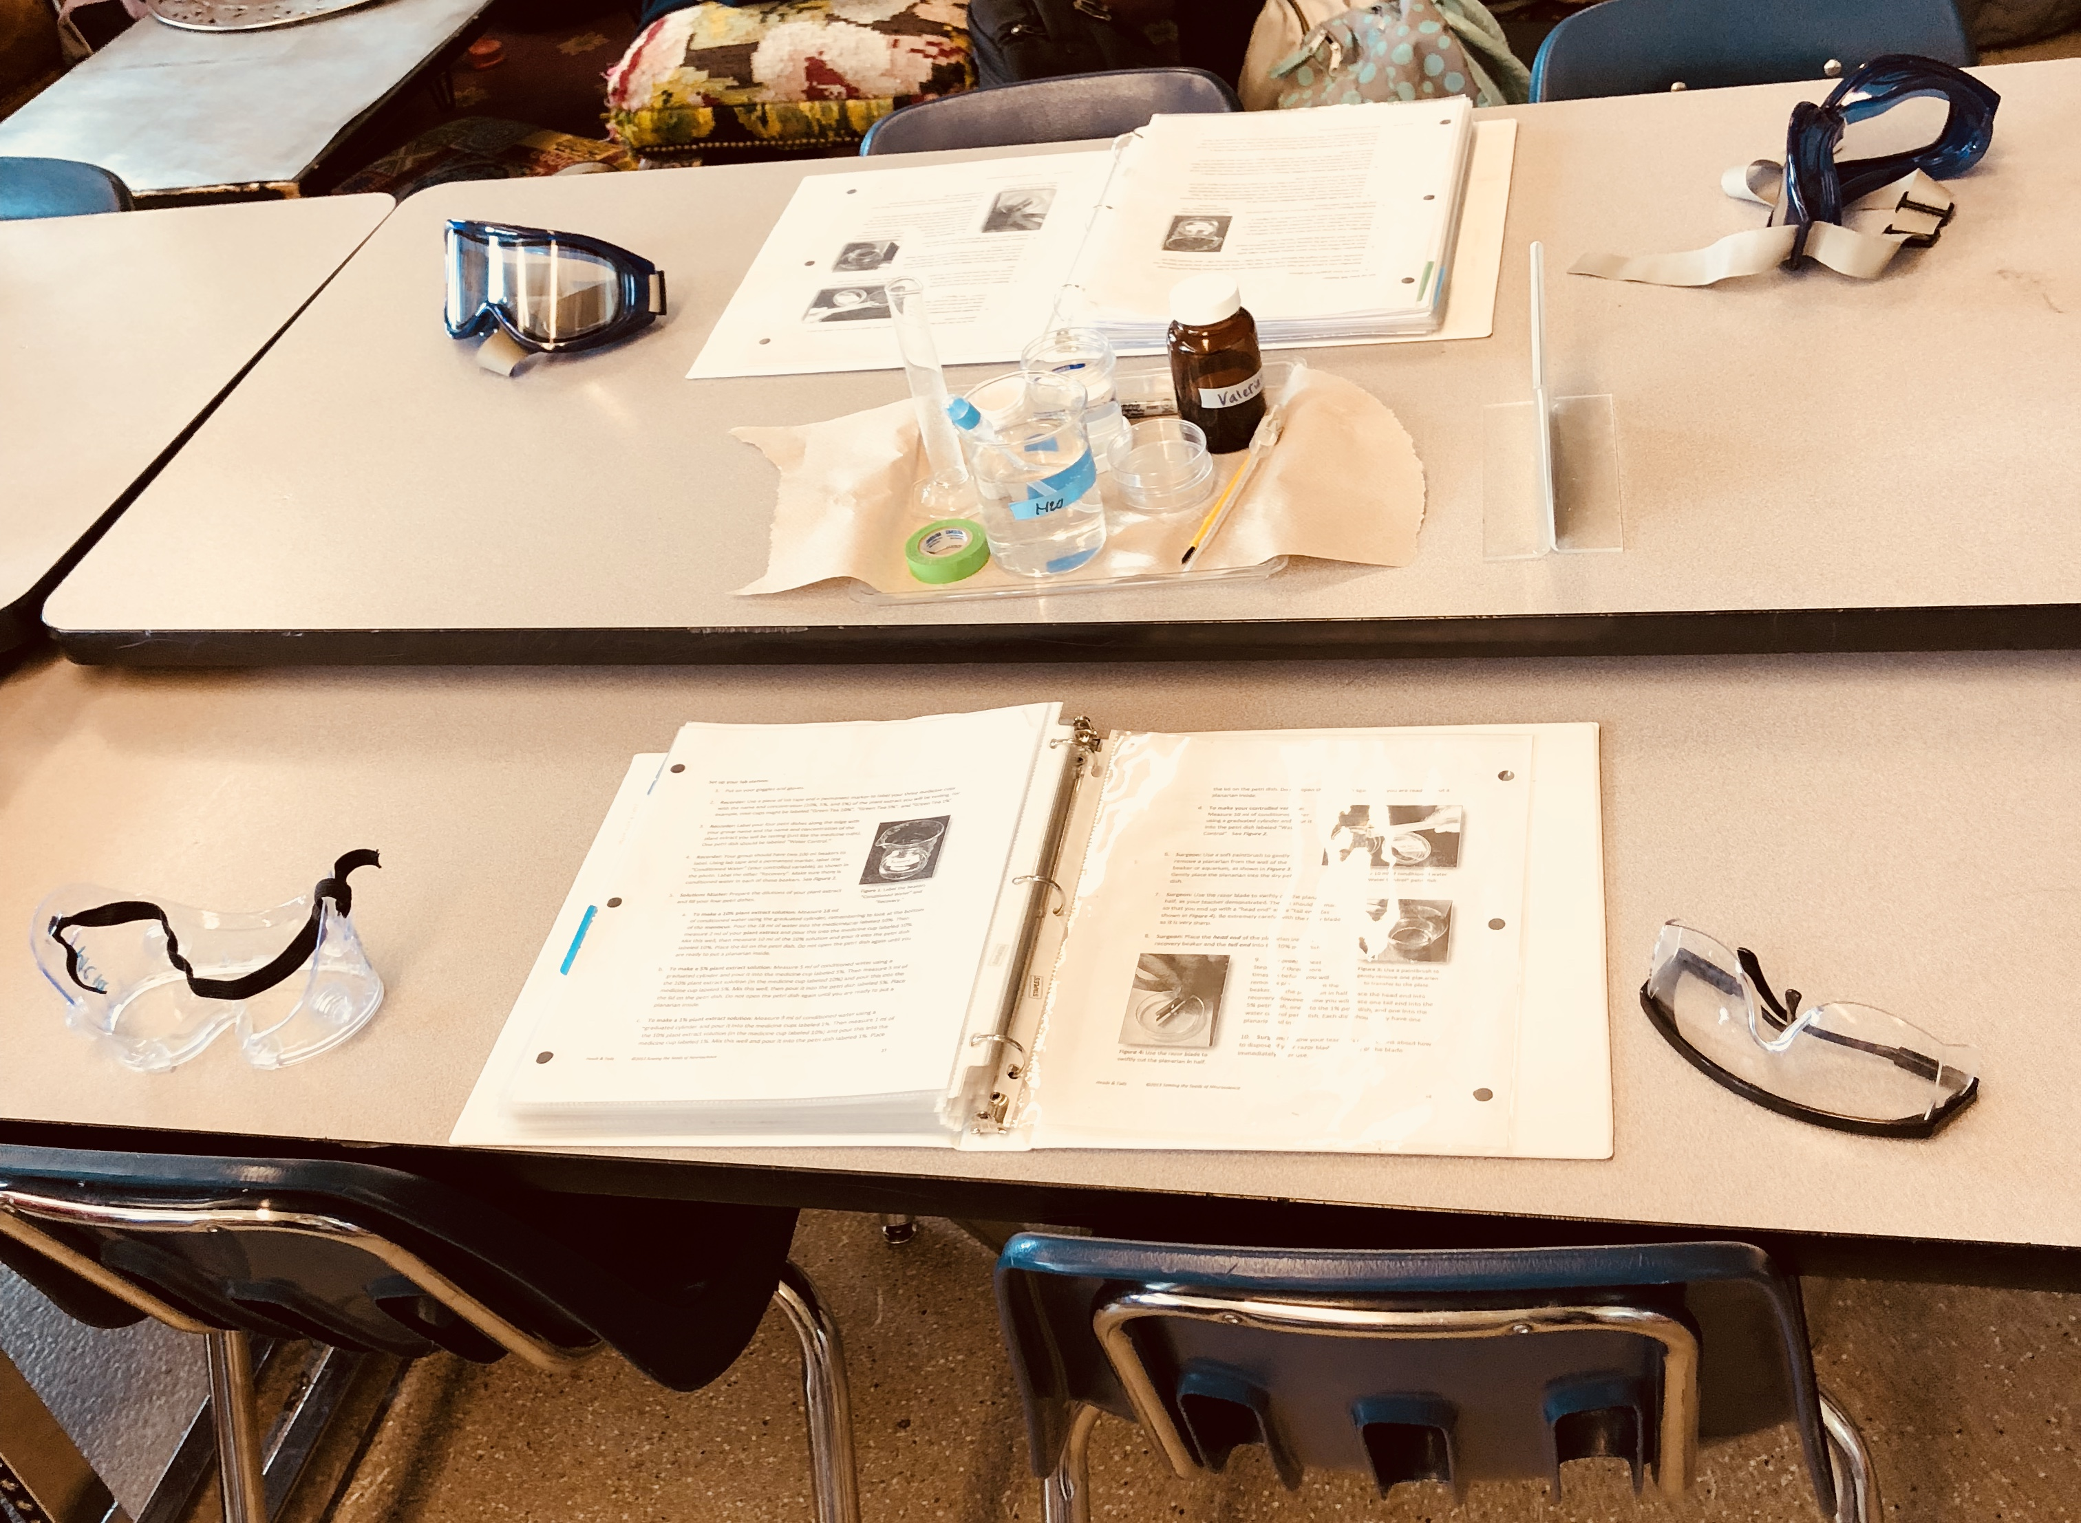
PART 2. FINISHING UP BEFORE YOU LEAVE
Solutions Master: Put petri dishes away where assigned
Observer: Notice where your plates went, you’re in charge of collecting them daily for “Recording”
Recorder: Properly set up station for next period’s lab
Observer: Properly dispose of non-reusable items
Recorder: Make sure everyone washes their hands

Slide 15
DAY 3-5. Lab Results…
Today you will be working with your team to complete your data tables and make observations so you can analyze your data at the end.

Slide 16
EQ: What makes STEM cells so important?
LEARNING TARGET
SUCCESS CRITERIA
I can analyze and interpret data for planarian cell growth
Collect quantitative and qualitative data for 3 days to be demonstrated in a graph at the end.

Slide 17
PART 1. INCUBATION PERIOD Day 1, Day 2, Day 3 Complete the steps below in order
Observer: Collect Plates for the Recorder
Recorder: Record signs of growth with a “Yes” or “No” on the data table
EVERYONE: Record the “Yes” or “No” on your data table and draw what the plate looks like on your lab report
Surgeon: Put petri dishes away where the teacher tells you
Solutions Master: Make sure everyone did their job correctly

Slide 18
PART 2. GRAPHING YOUR DATA
Count the number of “yes” answers for each concentration of chemical water solution.
Make a bar graph for the number of days the worm showed signs of growth.
DON’T FORGET TO USE THE GRAPHING CHECKLIST…
DISPLAYING DATA:
Selected appropriate graph: BAR LINE SCATTER PLOT |  |  |  |  |  |  |  |  |  | /1
Graph has a title |  |  |  |  |  |  |  |  |  | /1
X-axis and Y-axis are properly labelled (Marking "X" and "Y" on the lines does not count) |  |  |  |  |  |  |  |  |  | /1
Units are labeled on all axis |  |  |  |  |  |  |  |  |  | /1
Equal increments are used on all axis |  |  |  |  |  |  |  |  |  | /1
Key is used if more than 1 data set |  |  |  |  |  |  |  |  |  | /1
Data is properly graphed: Line graphs start at 0, Bar graphs have different heights, graph matches the title |  |  |  |  |  |  |  |  |  | /2
 |  |  |  |  |  |  |  |  | TOTAL | /8

Slide 19
REVISED THOUGHTS
What was surprising?
What did you already know but see in a new way?
What do you still need help with?

