Slide 1
Relevant & Irrelevant Data
Data Analysis

Slide 2
EQ: Which noticeable Data Table patterns Can be used as evidence?
LEARNING TARGET
SUCCESS CRITERIA
Use mathematical reasoning when analyzing data to determine the most relevant information to share in a CER.
Classify given evidence statements for relevant and Irrelevant data on a T-chart to represent significance.

Slide 3
How do you choose which data to use for your CER?
STEP 1: Turn & talk for 1 minute
1
STEP 2: Analyze the next slide
2
STEP 3: Decide with your partner…
3

Slide 4
What is the most relevant data? What is the least relevant data?
AVERAGE TEMPERATURE CHANGE IN DIFFERENT MATERIALS
 |  | DEGREES CELSIUS
Types of Materials (INSULATORS) | 1st Pd Avg. Temp Change | 2nd Pd Avg. Temp Change | 3rd Pd Avg. Temp Change | 5th Pd Avg. Temp Change | 6th Pd Avg. Temp Change | TOTAL AVG
Bubble Wrap | 10.5 | 4.5 | 4.0 | 5.0 | 2.0 | 5.2
Cotton Balls | 2.5 | 3.5 | 2.5 | 2.0 | 2.0 | 2.5
Sand | 8.0 | 10.5 | 10.5 | 13.5 | 6.0 | 9.7
Shredded Paper | 3.0 | 3.0 | 4.0 | 6.0 | 3.0 | 3.8
Fleece | 2.5 | 3.5 | 3.0 | 3.0 | 2.0 | 2.8
Air | 2.5 | 4.5 | 4.5 | 4.0 | 1.0 | 3.3

Slide 5
Record your thinking before looking at the next slide…
What do you think “Relevant” and “Irrelevant” means?

Slide 6
Which insulator prevents temperature change the best? Why is this the most relevant data?
AVERAGE TEMPERATURE CHANGE IN DIFFERENT MATERIALS
 |  | DEGREES CELSIUS
Types of Materials (INSULATORS) | 1st Pd Avg. Temp Change | 2nd Pd Avg. Temp Change | 3rd Pd Avg. Temp Change | 5th Pd Avg. Temp Change | 6th Pd Avg. Temp Change | TOTAL AVG
Bubble Wrap | 10.5 | 4.5 | 4.0 | 5.0 | 2.0 | 5.2
Cotton Balls | 2.5 | 3.5 | 2.5 | 2.0 | 2.0 | 2.5
Sand | 8.0 | 10.5 | 10.5 | 13.5 | 6.0 | 9.7
Shredded Paper | 3.0 | 3.0 | 4.0 | 6.0 | 3.0 | 3.8
Fleece | 2.5 | 3.5 | 3.0 | 3.0 | 2.0 | 2.8
Air | 2.5 | 4.5 | 4.5 | 4.0 | 1.0 | 3.3

Slide 7
Which insulator had the biggest variety of different temperatures? Why is this the LEAST relevant data?
AVERAGE TEMPERATURE CHANGE IN DIFFERENT MATERIALS
 |  | DEGREES CELSIUS
Types of Materials (INSULATORS) | 1st Pd Avg. Temp Change | 2nd Pd Avg. Temp Change | 3rd Pd Avg. Temp Change | 5th Pd Avg. Temp Change | 6th Pd Avg. Temp Change | TOTAL AVG
Bubble Wrap | 10.5 | 4.5 | 4.0 | 5.0 | 2.0 | 5.2
Cotton Balls | 2.5 | 3.5 | 2.5 | 2.0 | 2.0 | 2.5
Sand | 8.0 | 10.5 | 10.5 | 13.5 | 6.0 | 9.7
Shredded Paper | 3.0 | 3.0 | 4.0 | 6.0 | 3.0 | 3.8
Fleece | 2.5 | 3.5 | 3.0 | 3.0 | 2.0 | 2.8
Air | 2.5 | 4.5 | 4.5 | 4.0 | 1.0 | 3.3

Slide 8
Why would you make a bar graph and not a line graph?
STEP 1: Turn & talk for 1 minute
1
STEP 2: Analyze the next slide
2
STEP 3: Decide with your partner…
3

Slide 10
Record your thinking before looking at the next slide…
What do you think “Relevant” and “Irrelevant” mean now?

Slide 11
looking at the next slideS…
Analyze the data to select 1 “Relevant” data point & 1 “Irrelevant” Data point.

Slide 12
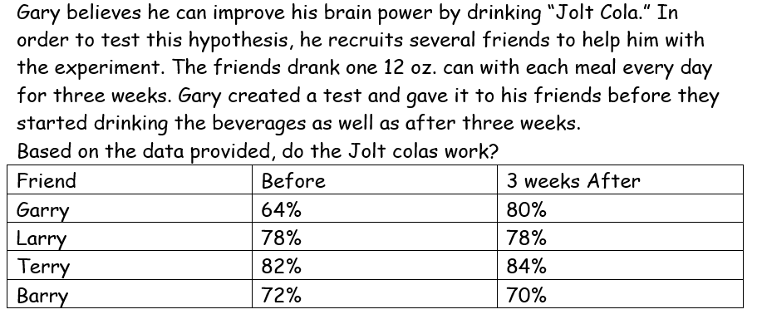
Practice finding Relevant & Irrelevant Data…

Slide 13
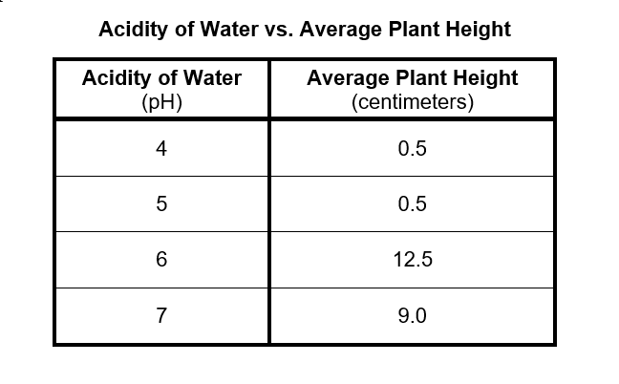

Slide 14
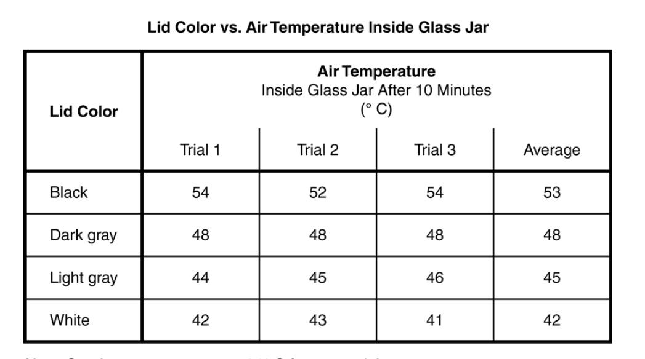

Slide 15
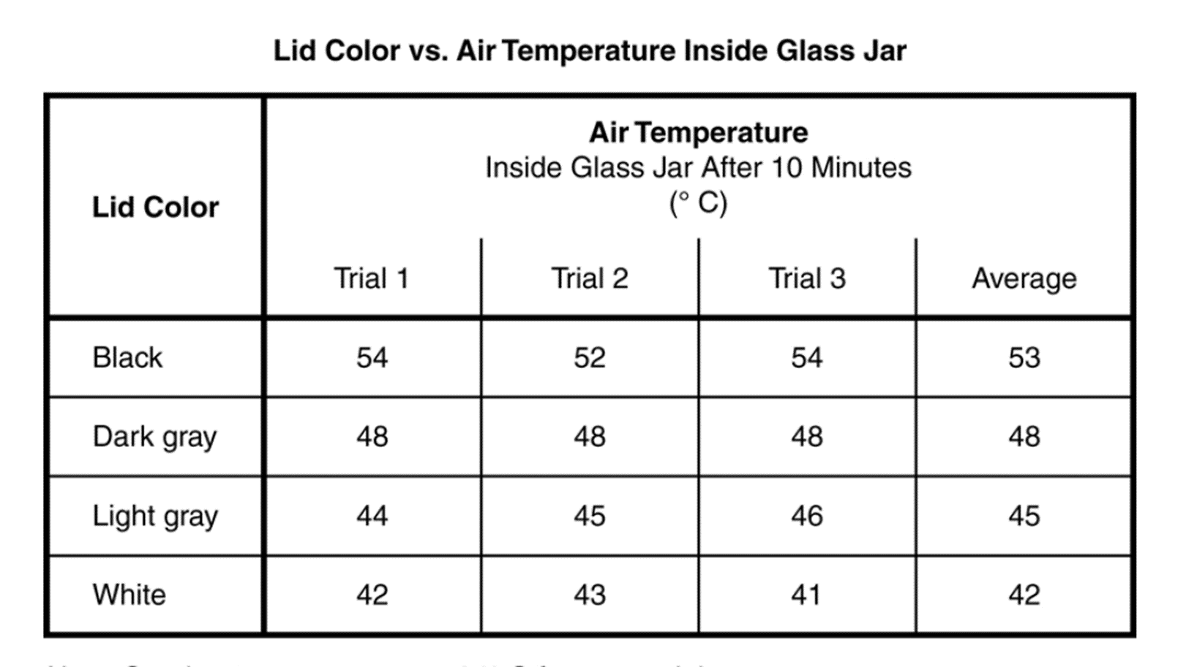
Practice Activity
STEP 1
Make a T-chart and label one side “Relevant” and the other “Irrelevant”
STEP 2
Use the strips of “Evidence Statements” and sort them into 2 piles. One for “Relevant Data” and the other for “Irrelevant Data.”
STEP 3
Compare them to the answer Key

Slide 16
EXIT TICKET
Why should you always use high/low quantitative data as 1 piece of evidence?
Why should you use mathematical difference and explain its significance as the reasoning to support the High/Low data?

