Slide 1
Citizen Science with the Zooniverse

Slide 2
LT & SC
Learning Target:
I can analyze and interpret data collected by real world scientists who are looking for patterns.
Success Criteria:
Create a zooniverse account and practice 15 minutes with 1 project.

Slide 3
What is citizen science?
The term “citizen science” refers to scientific research that is conducted by volunteers who are typically non-scientists
It involves people working with professional scientists on a variety of subjects
Notes:
People from all over the world, including students, contribute to scientific research in subject areas such as biology, astronomy, physics and medicine.

Slide 4
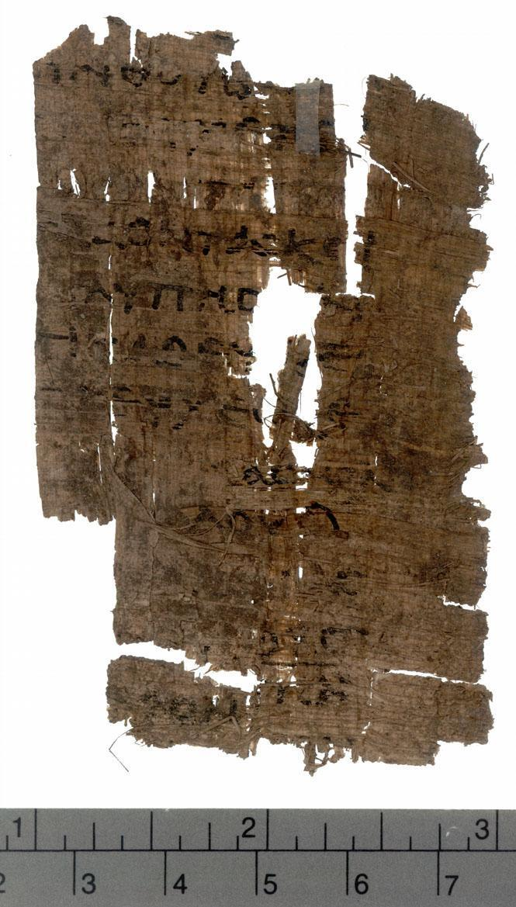
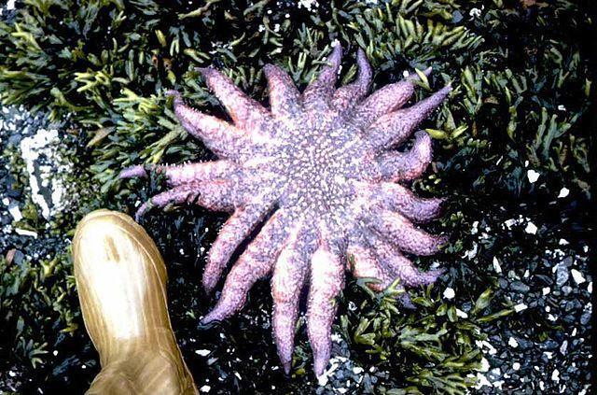
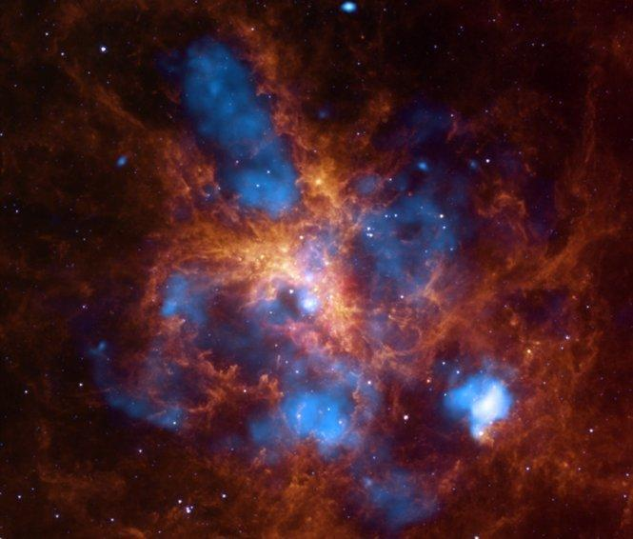
Citizen Science in Zooniverse
A public program where scientists post their research projects and ask us to help them evaluate their data
Projects to classify: ocean life, weather, ancient writings, astronomy and more…
Notes:
Zooniverse is a collection of citizen science projects in which volunteers help researchers review and classify the data they have collected, often pictures. Scientists or grad students upload their projects, but simply don’t have enough time in a day or the money to pay people to review this data, so they depend on volunteers to get the job done. It only takes a few minutes to register and learn what to do in these projects to start classifying data.

Slide 5
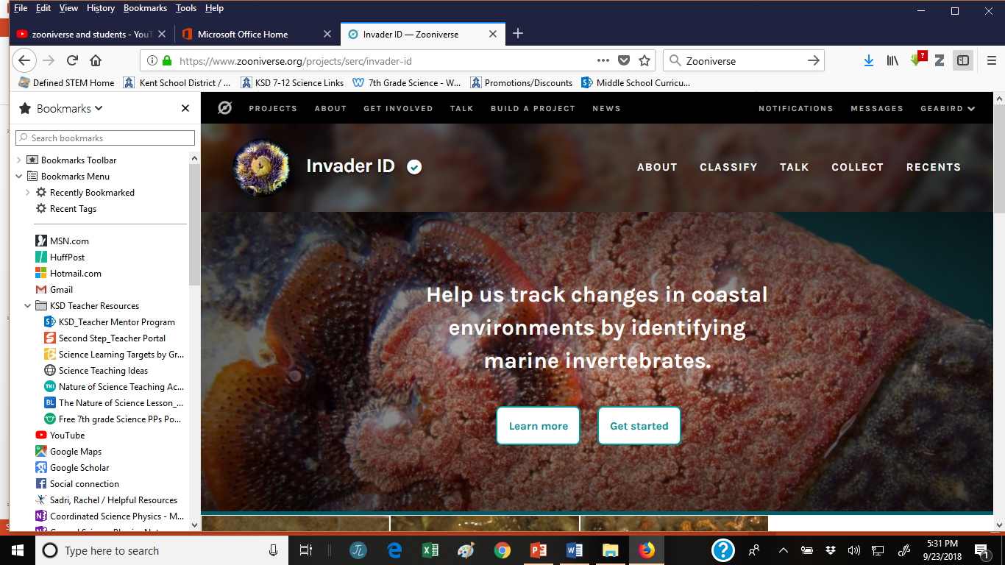
Zooniverse Citizen Science Examples
Notes:
This is one I recently examined.

Slide 6
Activity Steps in
Step 1: Create a personal gmail account if you don’t have one already.
Step 2: Go to the Zooniverse website: zooniverse.org
Step 3: Create an account with your gmail account.
Step 4: Select a science/nature project and follow the tutorial.
Step 5: Work with the project for 10 minutes, then try a different one. When you have tried at least three projects, decide which one seems easiest and make that your first project.

Slide 7
Send a Screen Shot
Go to “My Profile” in upper right hand corner of the screen.
On next screen, click the tab “Your Stats”
Use the snipping tool on your computer to take a screen shot of that number.
Send me an email and attach your screen shot.
Every time you complete 90 classifications, I will put a sticker on your “Service Learning” chart.

Slide 8
Review and Discussion
Which project did you pick?
What does your project monitor and how?
Why is it being monitored?
How does this research project benefit society?
Notes:
If there is time…or can ask these when moving around the room.

