Slide 1
LEARNING TARGETS
EQ: How can we use models to help us learn and solve problems?
LT: I can describe why some objects sink and others float.
SC: Revise the lava lamp model to include the phenomenon of “Density”.

Slide 2
Review: Back to Lava Lamps…
WITH YOUR PARTNER, ANSWER THESE QUESTIONS IN THE NOTEBOOK:
Describe how the lava lamps show density (Use reasoning).
What is more dense, and less dense in our Lava Lamp Light?
What is more dense and less dense in our Fizzy Tab Lava Lamp?
How can we draw that in a model? (Brainstorm ideas).

Slide 3
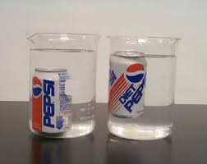
INITIAL THOUGHTS: Sink or float? 1. What is the difference between these two cans of soda? 2. Which has high density? 3. How is this like the lava lamps?
Objects that have high density sink
Objects with low density float
(If we have time, after we write Revised Thoughts we will watch this)
Follow this link to watch the SESAME STREET SCIENCE LINK & make predictions about what will sink or float?

Slide 4
REMEMBER: COMMUNITY OF SCIENCE SAYS… “Models are never finished… They are our best understanding so far.”
HOW DOES YOUR MODEL EXPLAIN THE PHENOMENON?
Might include things we cannot see.
Must include rules

Slide 5
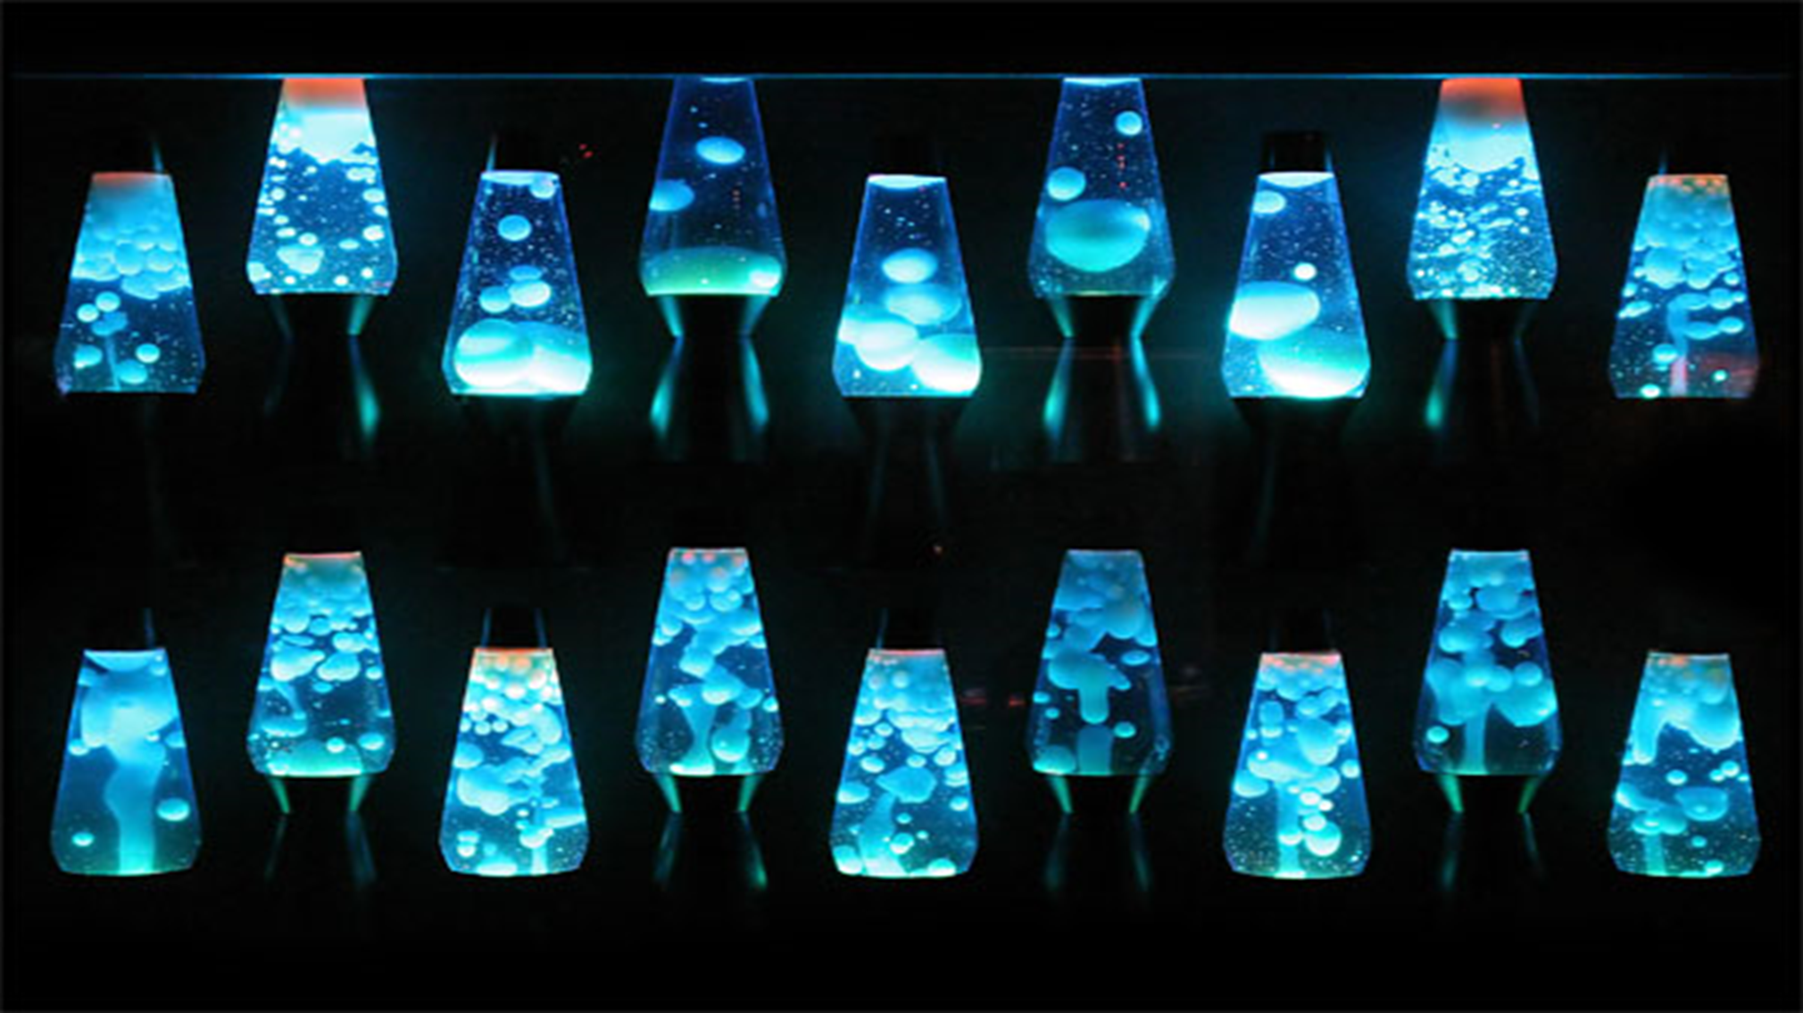
USING RULES of MODELS (Again)
In your lab groups, Use your “Models notes & rules” to check your models.(Give feedback and continually check each other’s work to make new iterations). Remember reiteration is a repetitive process? Giving feedback is part of the process.

Slide 6
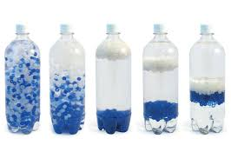
Scientific Models
AS A TEAM: Use your models checklist.
Practice using the “Science Rules” to revise your model. Rules of inputs/outputs for matter AND energy
Rule of density
Show on your model what is more dense and less dense.
Is it a model or a diagram? Doublecheck!!!!!!

Slide 7
REVISED THOUGHTS: Rules of Models & Density
What was surprising?
What did you already know but see in a new way?
What do you still need help with?

