Slide 1
Systems networking

Slide 2
Today’s agenda
Learning Target
I can use mathematical and computational thinking to critique points (nodes) in a system.
Success Criteria
Complete the Systems Networking histograms.
Notes:
In electrical engineering, a node is any point on a circuit where the terminals of two or more circuit elements meet.
A histogram is a type of graph where the data is grouped into ranges (such as 0-5).

Slide 3
Initial thoughts (IT)
List as many systems as you can think of (can be living, non-living, or human made systems).
What qualifies them to be called a system?
Notes:
What is a system? It is two or more parts working together to get a job done. What are some systems you thought of?

Slide 4
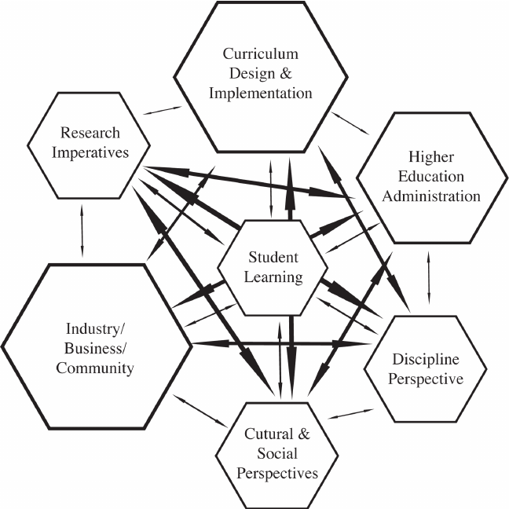
How does systems networking work?
Student 1
To understand how systems networking works, let’s say everyone in a class of seven students has a phone.
Let’s start with one student and ask how many people in the class he/she has a connection with, such as through texting, social networking, email, phone #, or gaming.
Then ask, who in this classroom does each of those people in the first student’s connections have connections with? Then add all those connections.
You will end up with something like the diagram to the right. This is a type of system network.
Student 6
Student 2
Student 7
Student 5
Student 3
Student 4
Notes:
).

Slide 5
WHAT IS A Node?
NODE 1
Engineers can look at any type of diagram or map and organize it in meaningful ways.
So if we look at the diagram of student connections (a system network) we can change the students to “nodes,” which are points of contact where one student has one or more connections with other students.
Engineers take a system network, look at how each node is connected in the network, and count the # of connections or edges.
Which of the 7 nodes has the most edges (# of connections)?
NODE 6
NODE 2
NODE 7
NODE 5
NODE 3
NODE 4

Slide 6
Example 1 on worksheet
1
4
5
2
3
How many nodes are there in this example?
How many edges (connections) does each node have?
For each node number, write down the number of edges each one has in the table on your worksheet (Node 1 has 1 edge, for example).
Next, draw a histogram with your data (next slide).
Node | # of Edges
1 | 1
2
3
4
5

Slide 7
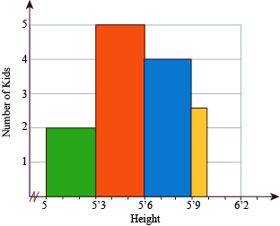
Example 1 on worksheet: Histogram
Node | # of Edges
1 | 1
2
3
4
5
A histogram is a type of graph where the data is grouped into ranges (such as 0-5, 6-10, 11-15).
See the example to the right, in which the height of kids are measured. Notice two kids measure 5 -5’3, and five kids 5’3 - 5’6. Count the number of things of the same number or range, and create a histogram from them.
Label your x and y axes. The x-axis always has the Manipulated Variable (Independent): What you change in an experiment. The y-axis always has the Responding Variable (Dependent): Something that responds to the changes you made in an experiment.
Notice that your histogram doesn’t have to include more than 4 edges (why?). Is that the responding or manipulated variable?
If confused, look online for guidance.

Slide 8
Complete the rest of the worksheet. Examples 2 and 3 are more complex systems, but you are creating tables and histograms the same way as you did for example 1.

