Slide 1

USE THE INITIAL THOUGHTS WORKSHEET FOR THE NEXT SLIDE

Slide 2
INITIAL THOUGHTS?
What does the word “system” mean to you?
What are some “SYSTEMS” you can think of or have heard of before? List as many as you can here.
Why might systems be important?

Slide 3
Systems Learning Objectives
I can define a system and subsystem(s) within a larger system.
I can describe how INPUTS and OUTPUTS affect a system.
I can predict how a system will change, given its inputs and outputs.

Slide 4
LEARNING OBJECTIVES
CONTENT OBJECTIVES (What are we going to learn?)
The definition of a system
Why systems are useful to us
LANGUAGE OBJECTIVES (How are we going to learn?)
Look at pictures of systems
Define parts of systems
Take notes
Discuss with teacher & classmates
Watch video clips
Try activity

Slide 5
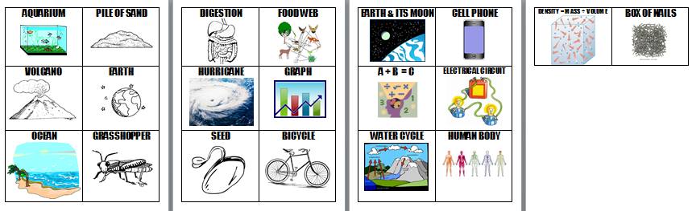
Is It a System?
Directions:
Work in a team of 3-4.
Look at all the pictures
Decide as a group if the object pictured is a system or not.
Create 2 piles—SYSTEMS and NOT SYSTEMS

Slide 6
Is It a System?
Basic Definition:
To be considered a system, the components (parts) must interact with each other in some way.
Does this change your choices?
If you remove a part of the system will it still function? If yes, its not a system…

Slide 7
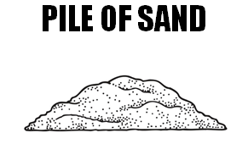
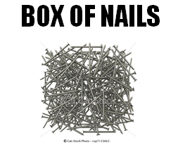
Is It a System?
Answer:
All of the choices can be considered a system EXCEPT a pile of sand and a box of nails…because the pieces of these 2 do not interact with each other!*
Notes:
***However you could argue that the atoms of the sand or nails interact with each other and therefor are a system by themselves….

Slide 8
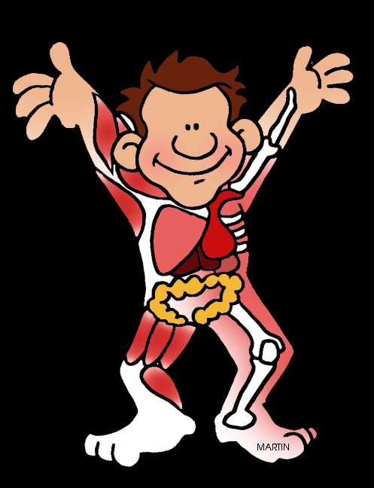
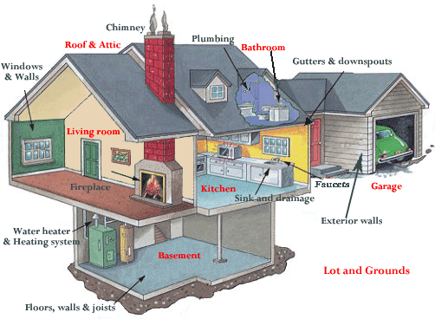
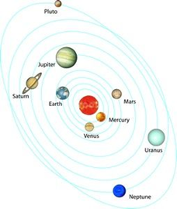
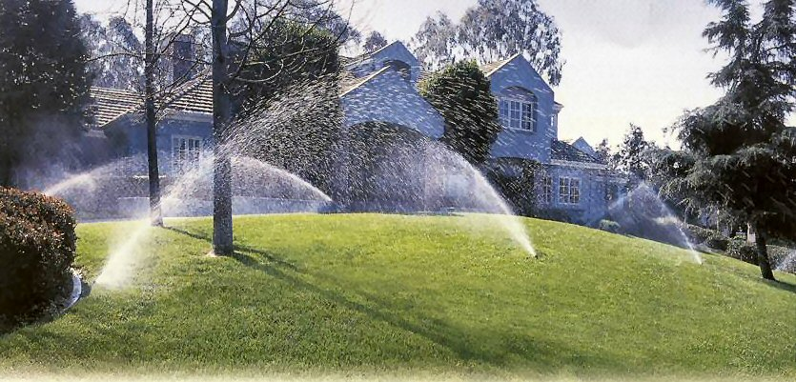
What examples of systems could you think of?

Slide 9
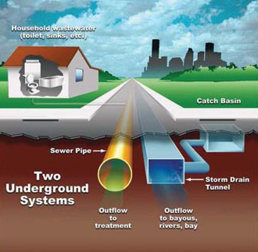
What examples of systems could you think of?

Slide 10
STOP & READ DIRECTIONS
USE YOUR GUIDED NOTES WORKSHEET TO COMPLETE THE REST OF THE POWER POINT!

Slide 11

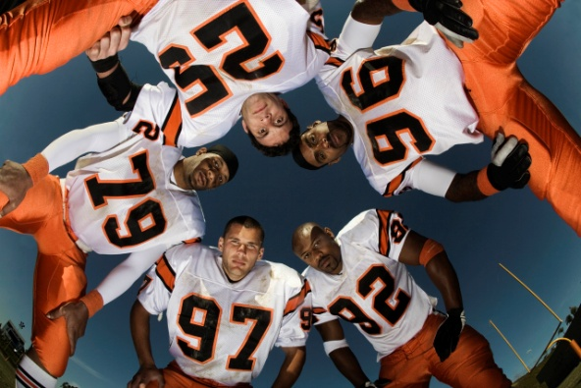
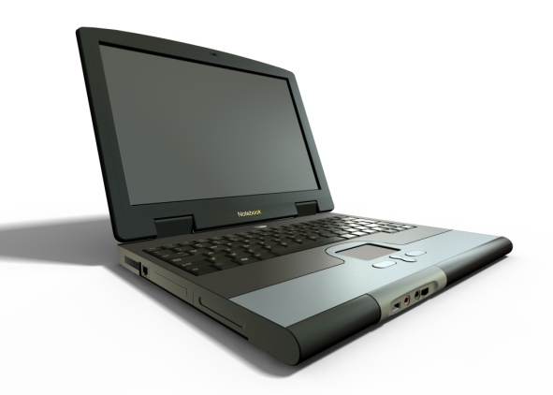
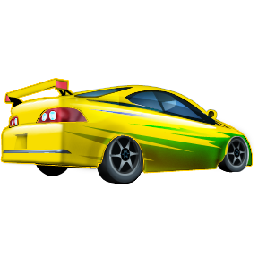
WHAT IS A SYSTEM?
Two or more parts that combine to perform a single function (Job, purpose) and combine to form a whole

Slide 12
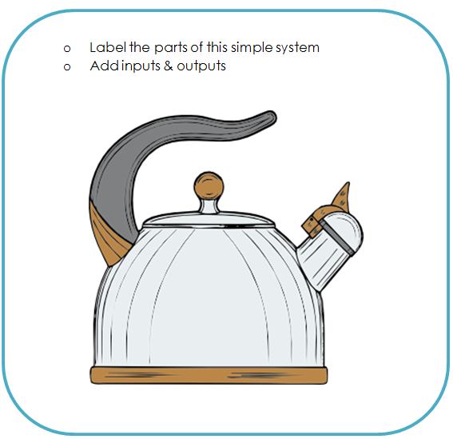
WHAT IS A SYSTEM?
Can you label the parts of the tea pot system?
handle
lid
Lid on spout
whistle
spout
What is the purpose of the teakettle?
To heat water!
Kettle/pot

Slide 13
INPUTS & OUTPUTS
INPUT: something that gets put INTO a system to help it do its job
Matter (“stuff”)
  Takes up space, has mass; made of atoms & molecules
Energy
Information
***not the same as a PART of the system

Slide 14





INPUTS & OUTPUTS
Possible Energies:
Electrical
Sound
Thermal (heat)
Light
Mechanical
Nuclear
Chemical (food is one example; a battery is another)

Slide 15
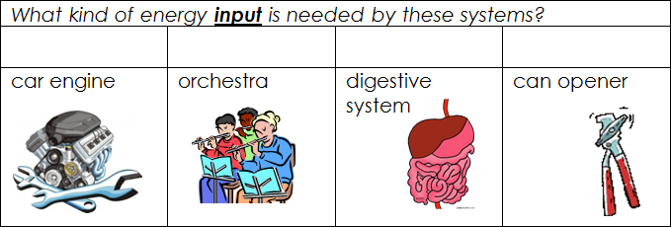
INPUTS & OUTPUTS
chemical
mechanical
chemical
mechanical

Slide 16
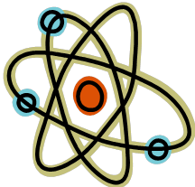
INPUTS & OUTPUTS
OUTPUT: something that comes OUT of a system when it does its job
Matter (“stuff”)
Energy
Information
***not the same as a PART of the system

Slide 17
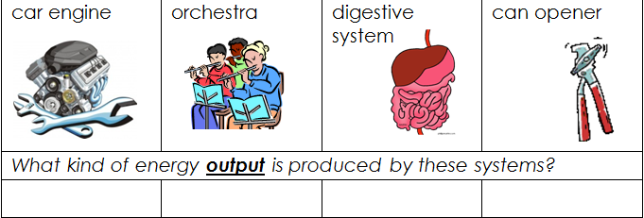
INPUTS & OUTPUTS
Mechanical,
chemical
sound
Thermal,
Mechanical,
Chemical
mechanical

Slide 18
INPUTS & OUTPUTS
Sometimes the output from one system can become the input for another system.
Example: Apple from a tree becomes food for you.

Slide 19
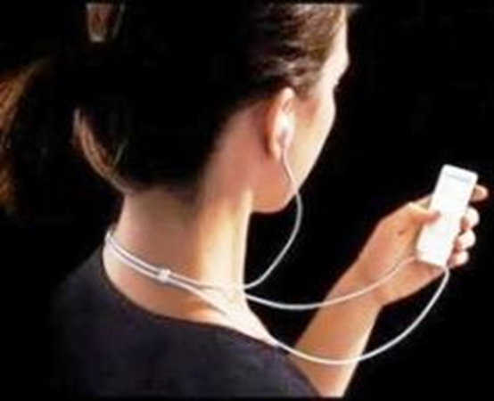
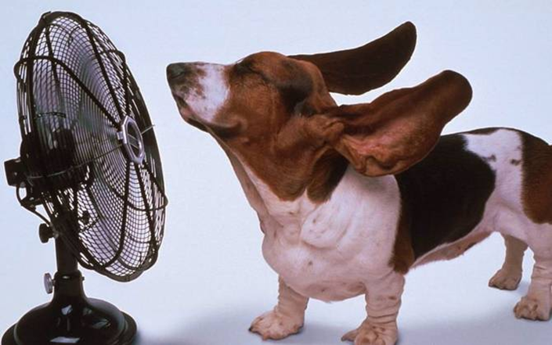
INPUTS & OUTPUTS
Sometimes the output from one system can become the input for another system.

Slide 20
INPUTS & OUTPUTS
Can you label the inputs and outputs of the tea kettle?
Red = input
Green = output
thermal
sound
Hot water
(liquid/gas)
water
thermal

Slide 21
HOW DO WE DEFINE A SYSTEM?

Slide 22
Systems Learning Objectives
I can describe the boundaries of a system and explain how those boundaries might change for the purpose of a study.
I can describe the difference between an OPEN and a CLOSED system.
I can explain how systems-thinking help us understand the natural and designed world.

Slide 23

TYPES OF SYSTEMS
OPEN SYSTEM:
both matter and energy can enter and leave (and information)

Slide 24
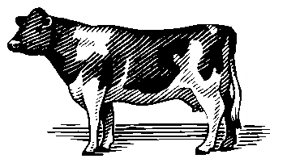
TYPES OF SYSTEMS
What kinds of energy are inputs and outputs for this system?
What kinds of matter are inputs and outputs?
Input: chemical, thermal
Output: chemical, thermal, sound
Input: Food, Output: Milk, Waste

Slide 25


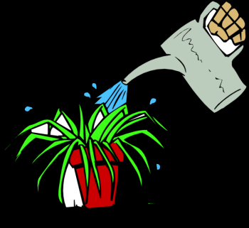
Open Systems--example
Plants are open systems. They have parts to help them survive. They take in light energy, plus matter (water and carbon dioxide and minerals) and give out matter (oxygen, new growth, leaves, fruit).

Slide 26

TYPES OF SYSTEMS
CLOSED SYSTEM:
matter CANNOT enter or leave – the amount of “stuff” stays the same; energy and information CAN enter and leave (only energy flows through the system)

Slide 27
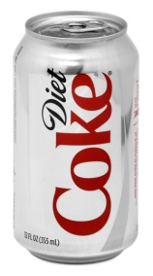
TYPES OF SYSTEMS
What kinds of energy can enter and leave this system?
Why can matter not enter or leave?
Input: thermal
Output: thermal, sound?
The top is closed!

Slide 28
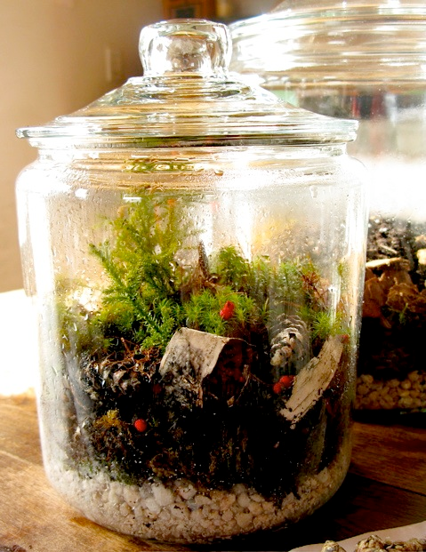
PLANT EXAMPLE
Closed can become open; open can become closed
if we expand our boundary to include the whole mini ecosystem that the plant is a part of, we are looking at a closed system. No matter can leave or enter the bottle ecosystem, though light and heat energy can.

Slide 29
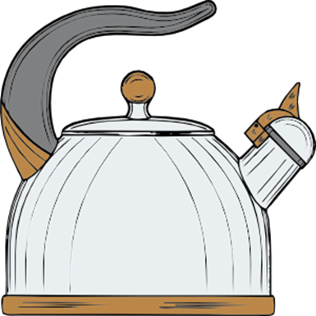
OPEN OR CLOSED?
*Identify if your picture/drawing above (teakettle) is an OPEN or a CLOSED SYSTEM. Explain why.
The teakettle is an OPEN system because matter (water) can enter and leave. Energy can enter and leave too, but that is true of any system.

Slide 30
OPEN SYSTEM
Matter can enter or leave
No matter can enter or leave
Information & energy can enter and leave
CLOSED SYSTEM

Slide 31
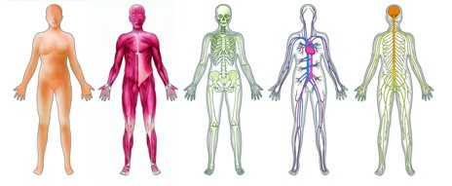
SUBSYSTEMS
SUBSYSTEM: smaller parts of a system that have their own JOB but also work in a LARGER system

Slide 32
SUBSYSTEMS
Does your system sketch have SUB SYSTEMS? Identify them here:
Can you think of other systems that have SUBSYSTEMS?
The whistle
The spout
The kettle?
Any multi-cellular living thing
Cars
Schools…the list goes on!

Slide 33
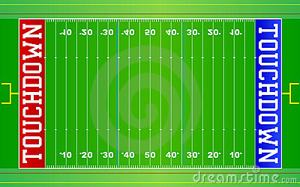
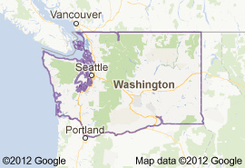
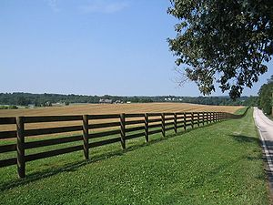
SYSTEMS HAVE BOUNDARIES
BOUNDARY: the outside border or surface of a system. It defines what system we are studying.

Slide 34

SYSTEMS HAVE BOUNDARIES
Person + Skateboard as a System
I can study the person and the skateboard

Slide 35
SYSTEMS HAVE BOUNDARIES
I can study just the person

Slide 36
SYSTEMS HAVE BOUNDARIES
I can study just the skateboard

Slide 37
SYSTEMS HAVE BOUNDARIES
Why?
We look at things systematically to understand them. Sometimes we look at the larger system, and sometimes we look at the smaller system that is a subsystem of the larger system.

Slide 38

SYSTEMS HAVE BOUNDARIES
Boundaries are determined by the way we study a system and how the parts of a system work together.

Slide 39
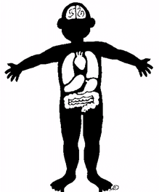
SYSTEMS HAVE BOUNDARIES
We (humans) can change boundaries when we want to think about just part of a system. For example, a doctor might consider your whole body system to see if you are healthy overall, or just look at your throat if you have a sore throat

Slide 40
SYSTEMS HAVE BOUNDARIES
When we study earth, we can study
The atmosphere
The land/continents
The oceans
Earth’s materials
Earth’s interaction with other planets
Humans define the BOUNDARIES

Slide 41
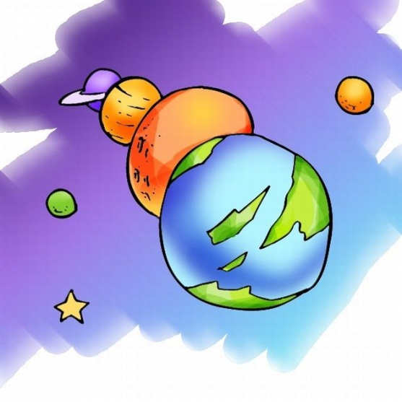


WHY USE SYSTEMS?
The universe is gigantic & complicated; using systems allow us to focus on what we want to study.
Think of systems as a flashlight for highlighting just what we want to study at one time.

